Slide 1
ASSESSMENT: KIWI KARS
Portfolio for 3.7 / 3.8
Callum Cooper

Slide 2
STEP 1 : DEFINE YOUR RELEVANT IMPLICATIONS
What are 3 relevant implications you will be focusing on?
Aesthetics, Functionality, Usability

Slide 3
IMPLICATION - AESTHETIC
Aesthetic – How appealing the website looks to a user and how well the theme matches.
The website should look visually appealing with a modern and sleek GUI using a vibrant color pallet. The site should look attractive to the user with consistent styled elements and a theme that is modern and matches what the target audience would enjoy. The site should not be overpowering for the user as it should be a simple design.

Slide 4
IMPLICATION - FUNCTIONALITY
Functionality – Ensuring that a website performs its specified task and adding extra options to make users lives easier.
All elements should work as intended and the site should be bug free and work without issues as to avoid turning users away. The site should work regardless of what web browser the user is using. In addition all data should be validated and checked, using patterns and other checks, before being sent to the database.

Slide 5
IMPLICATION - USABILITY
Usability – How easy the user is able to interact with the website and preventing the user from inputting erroneous data
Users should have no difficulty pressing buttons or filling in input fields and all types of devices should be able to use the website effectively by using media queries to resize the website to better allow the user to see elements on the website. The step by step form should be used with submit buttons and allowing the user to go back to change their settings. Users should not be able to add information that should not be added such as phone numbers in first name inputs.

Slide 6
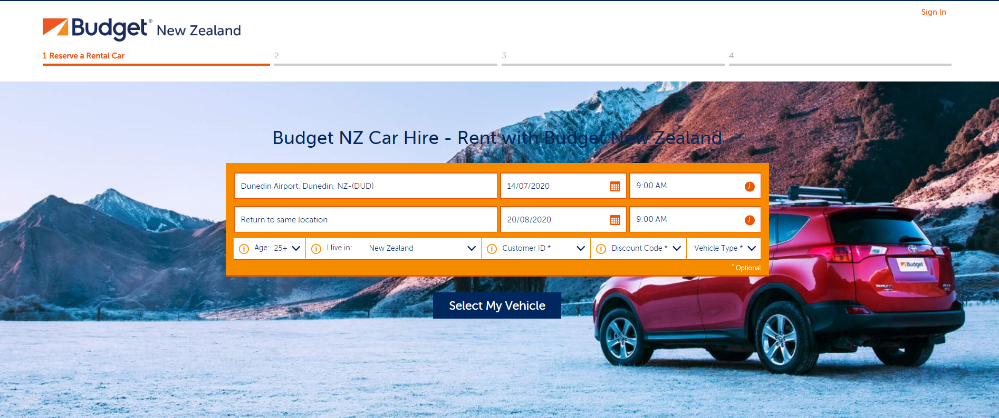
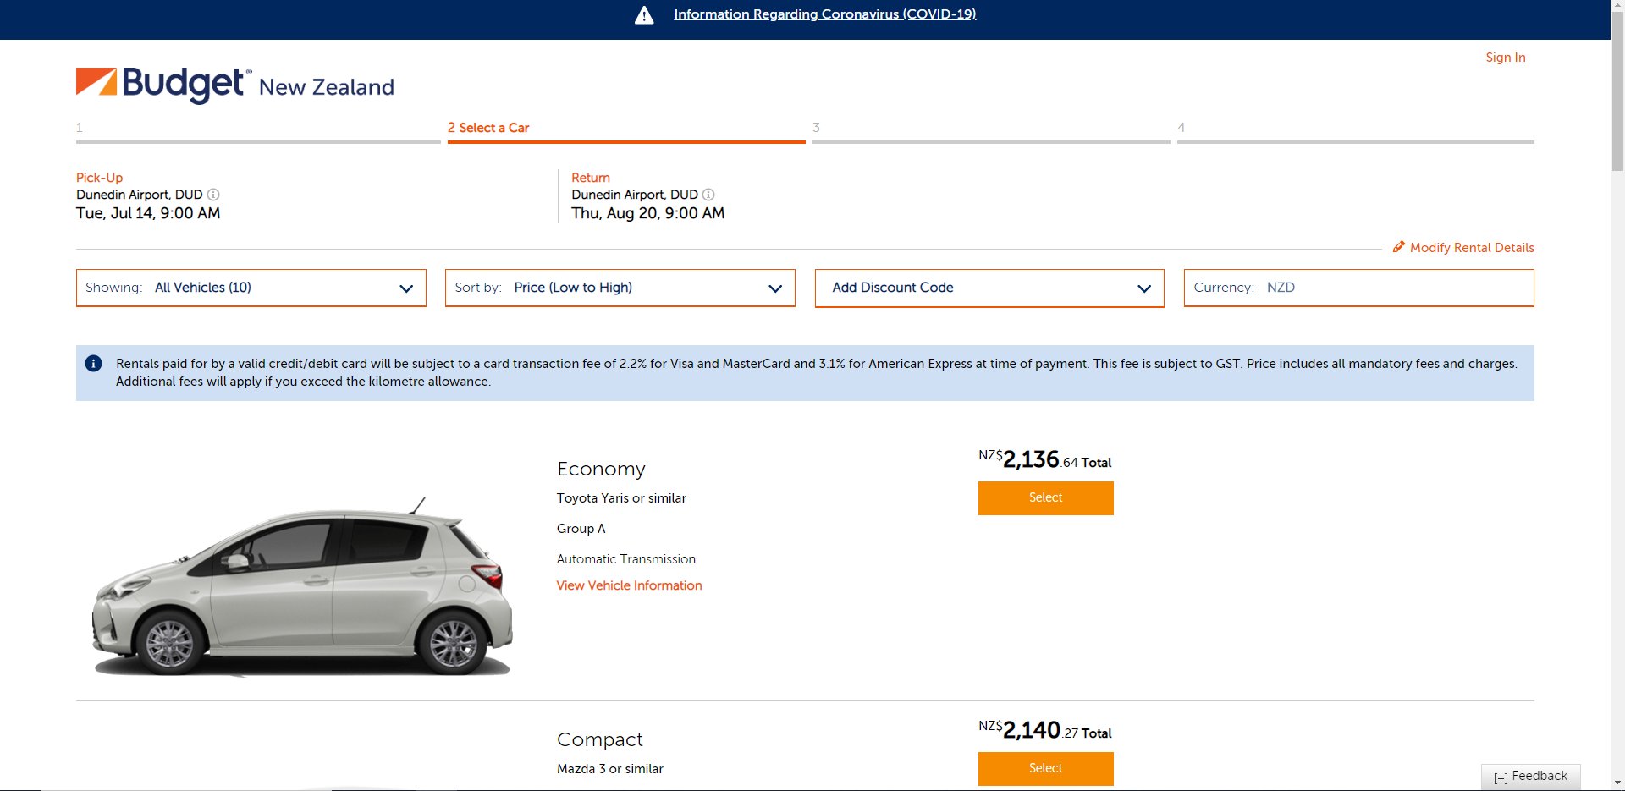
Web Research- www.budget.co.nz
Usability - Gives a drop down of available locations for user to choose from
Functionality - allows the user to sort the cars to better find a car.
Functionality - Pre calculated price keeps it simple to understand for user
Robust - does not allow user to move on until correct pick up date is entered. Must be today or later.
Aesthetics - too much orange on booking form
Aesthetics - All pictures are pointing the same way and in the same position
Aesthetics - Simple color scheme that matches the brand colours.

Slide 7
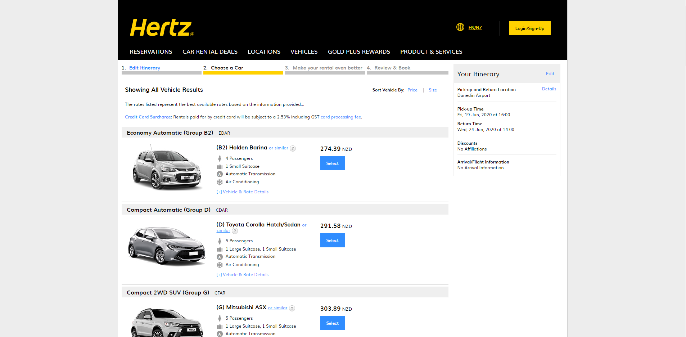
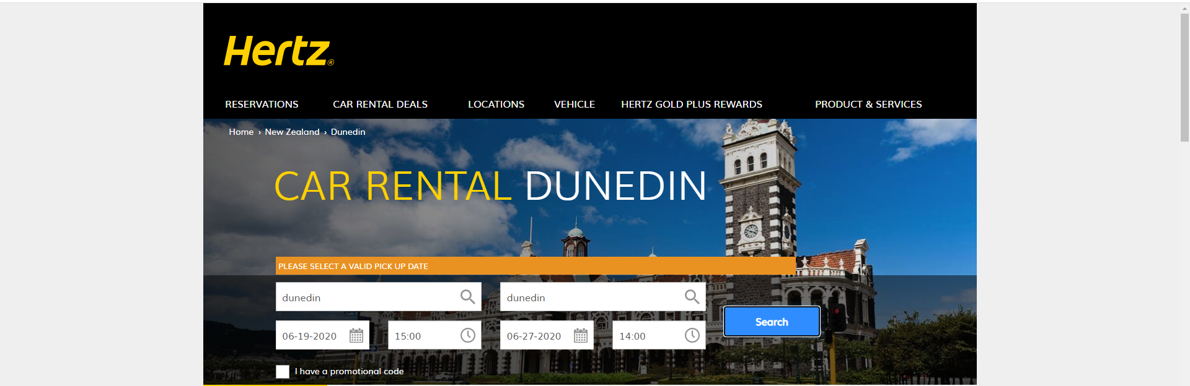
Web Research - www.hertz.co.nz
Aesthetics - Dull grey borders that cover up much of the screen
Usability - Forces the user to enter valid information however error message isn’t specific to which field is erroneous just general error message
Aesthetics - bland and boring font choices.
Color scheme is dull, blue grey and yellow don’t match very well.
Functionality - Pre calculated car costs.
Shows your already confirmed details on the side so the user doesn't have to check.

Slide 8
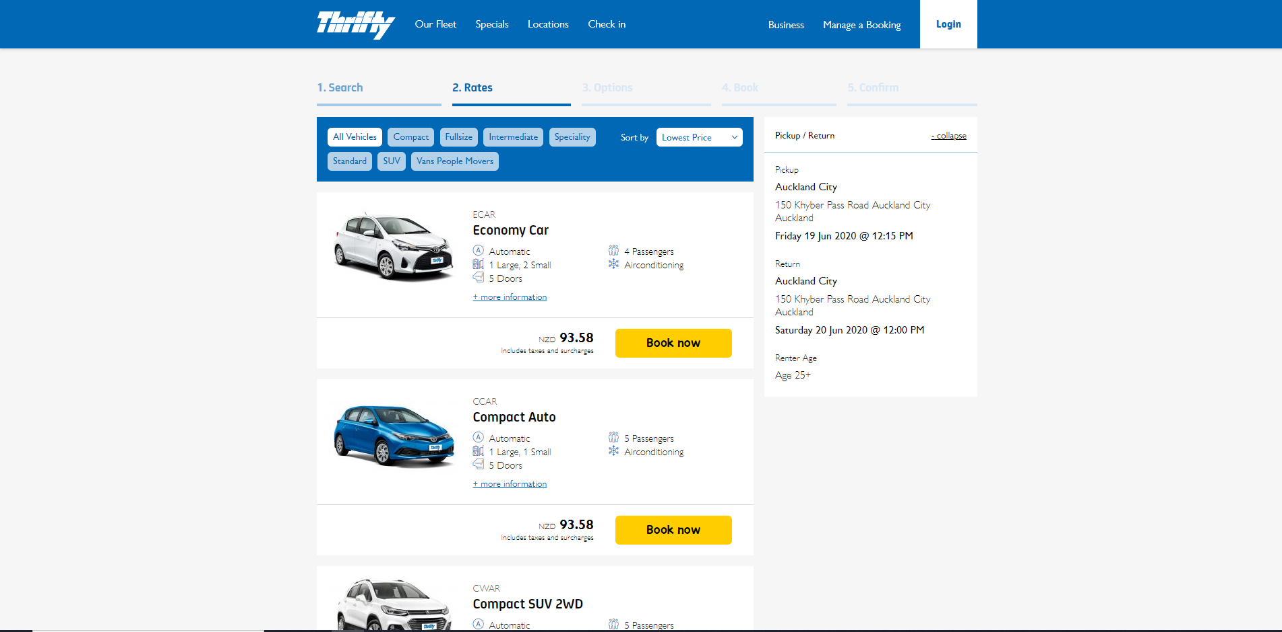
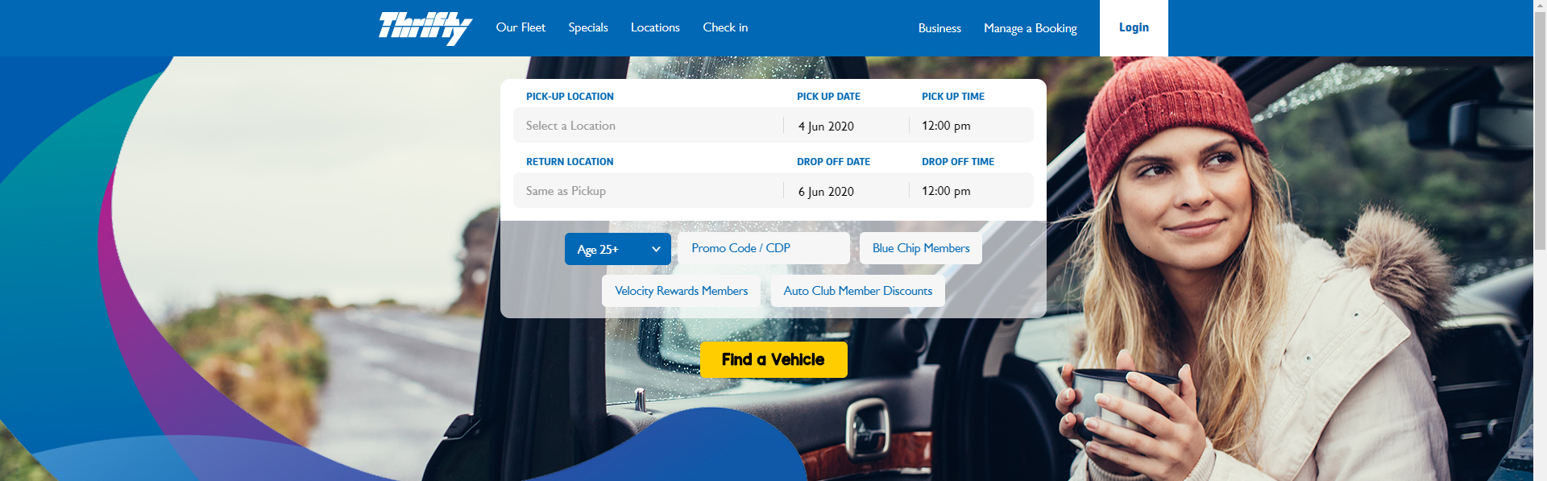
Web Research - www.thrifty.co.nz
Aesthetics - Vibrant and modern color scheme.
Font scheme is unique and looks appealing
Functionality - pre calculated car costs
Side bar shows the users selected options
Usability - Navbar easily allows users to navigate the site.
Aesthetics - modern style. Vibrant buttons
Too much blue - more color pop needed.
Functionality - Drop down menu to select pick up location - robust

Slide 9
STEP 1 : DEFINE YOUR AUDIENCE
Who is your target audience?
The target audience will largely be tourists who are looking to rent a car and thus the majority will not be from Dunedin and may be from overseas. The audience must be older than 25 so that they can book the car however they will most likely be younger than 50. Other users may be parents looking to book a hire car for a family and may require extras such as a booster seat.

Slide 10
USERS ACCESSING THE SITE
How are they most likely going to be viewing your GUI?
50% of users use their mobile phone to access the internet while 46% use desktop and 4% use a tablet
The majority will be accessing the site using a mobile phone, 60% will be using Chrome while 25% will be on Safari.
Almost the same amount of people as mobile will be using a desktop computer – according to https://gs.statcounter.com/browser-market-share/desktop/worldwide around 70% will be using Chrome with both Safari and Firefox taking up 10%.
Some users may also be using a tablet with almost 50% of these using Safari as their primary browser while Chrome has a 35% user rate on tablet.
Therefore, both chrome and safari are the majority for browser usage with other browsers such as Firefox and Opera also seeing a small percent of usage.

Slide 11
DEFINE THE KEY STEPS OF THIS PROJECT
Record the client specifications
Create Trello board to manage tasks
Ideate (wireframe (GUI), Google fonts / colours)
Prototype: Create the GUI, test inputs work, perform calculations, test outputs, form validation and error messages, create firebase project, connect to firebase and push data
Testing : ongoing and should involve A vs B testing with end users

Slide 12
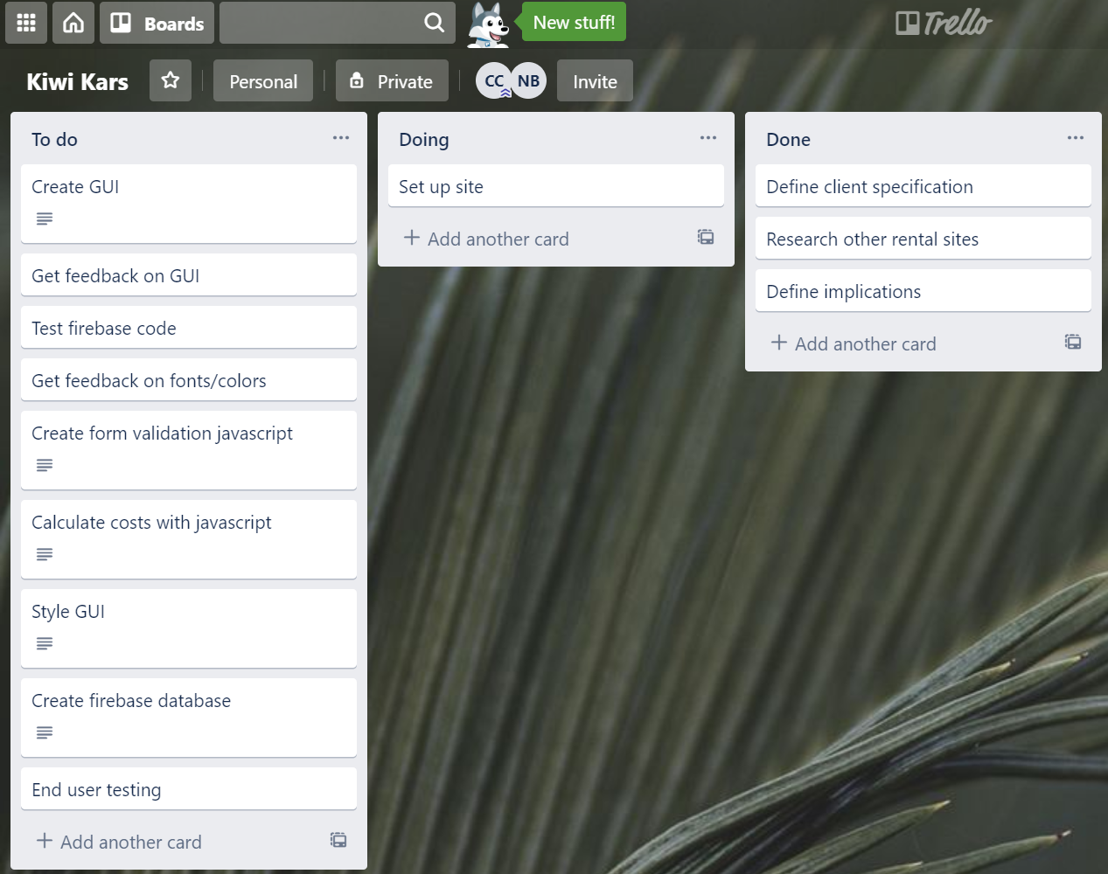
PROJECT MANAGEMENT TOOL: TRELLO
Kiwi Kars Trello board - https://trello.com/invite/b/ocJI7tRX/982458990f7634f51726567730c68981/kiwi-kars

Slide 13
Version Control
https://github.com/callumc20171/3.7-Assessment

Slide 14
Client Specifications:
The Programs Specifications
•The top of the page must contain their Company name and logo heading
•A footer containing their contact details
•The GUI should clearly display each of the vehicles with a photo, daily hire price and their corresponding description
•The user should then be allowed to select a vehicle
•Allow users to select from extra options (listed above)
•Select their number of days – number input (max 14)
•Pick up date – date input
•A reservation summary which outputs the detail of their reservation with an itemised breakdown of the total cost.
Once the user has selected their vehicle, allow them to add in their details
•First name
•Last name
•Age (if they are younger than 25, they cannot make a reservation)
•Cell phone number
•Email address
•A checkbox that the user must tick to ensure they agree to our Terms and Conditions before proceeding to a button confirming their reservation and then output the pop up message.
The program must store all of the booking details to a real time Firebase database
Extra items a user can add to their reservation includes:
Snow chains - $60
Roof racks - $90
Bike rack (fits max 3 bikes) - $120
GPS - $35
Child Booster Seat (9kg -36kg) - $50
the total hire price is calculated by the vehicles price per day by the number of days the vehicle is hired for. You will need to add on a mandatory $20 per day insurance fee plus a one off standard booking fee of $50.

Slide 15
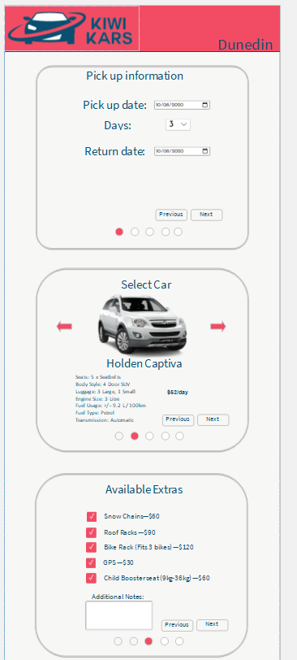
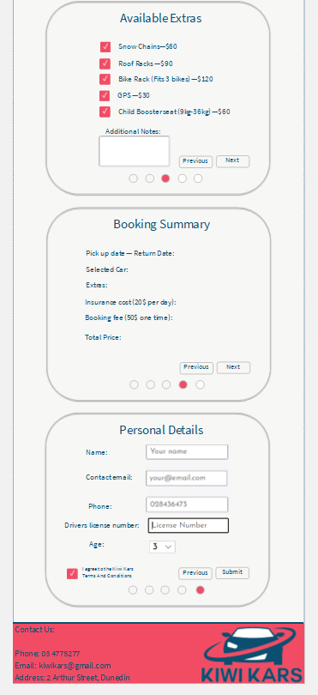
STEP 2:IDEATE (HIGH FIDELITY WIREFRAME)
1)It look very professional. The layout flows well with the information, it’s very step by step which I like. The select a car function is something even I may think about doing.
2) Colours contrasting does not work overall, it makes it visibly hard to read, especially the nav bar and footer

Slide 16
WIREFRAME FEEDBACK

Slide 17
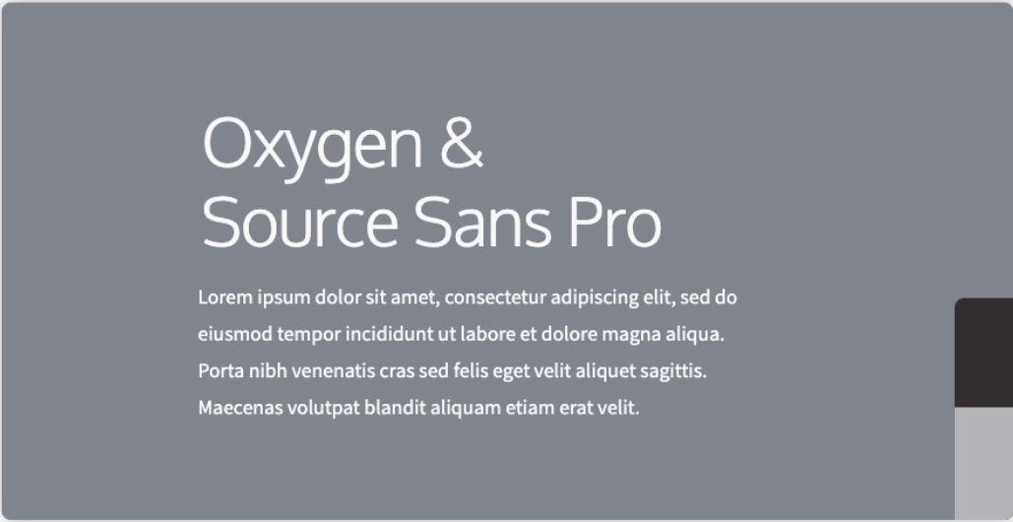
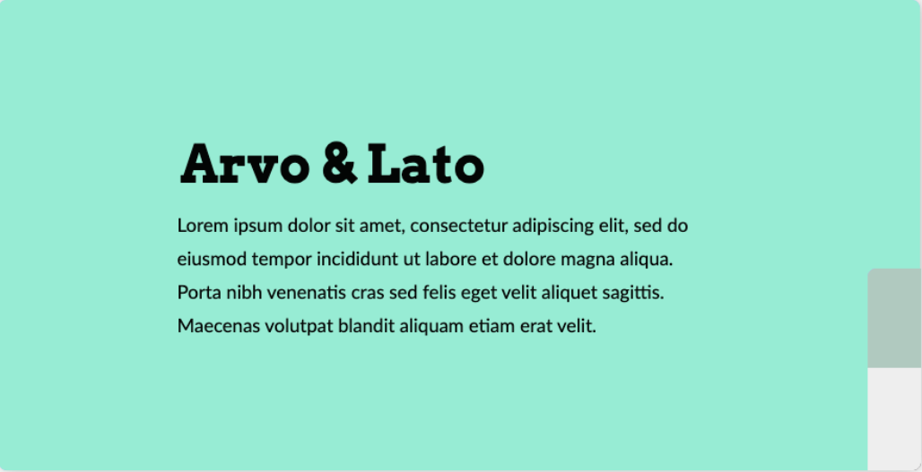
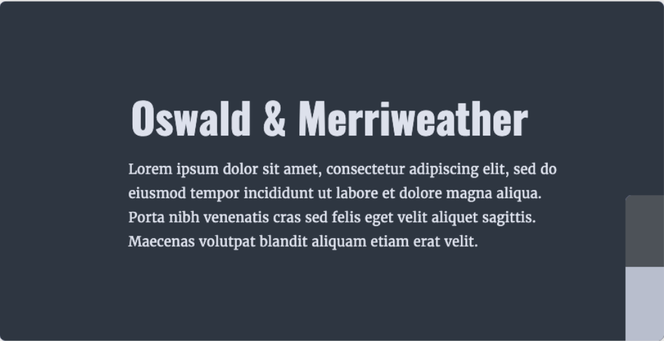
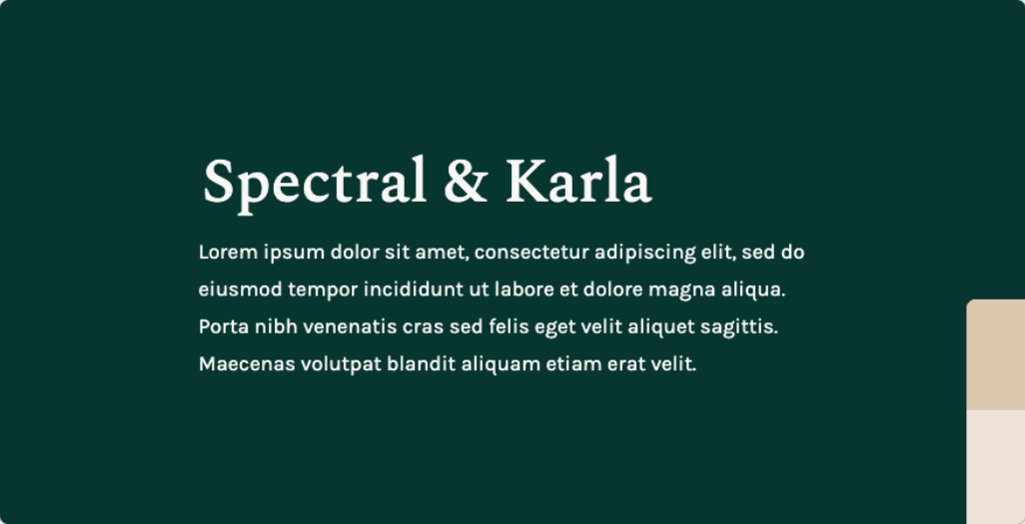
FONT COMBINATIONS

Slide 18
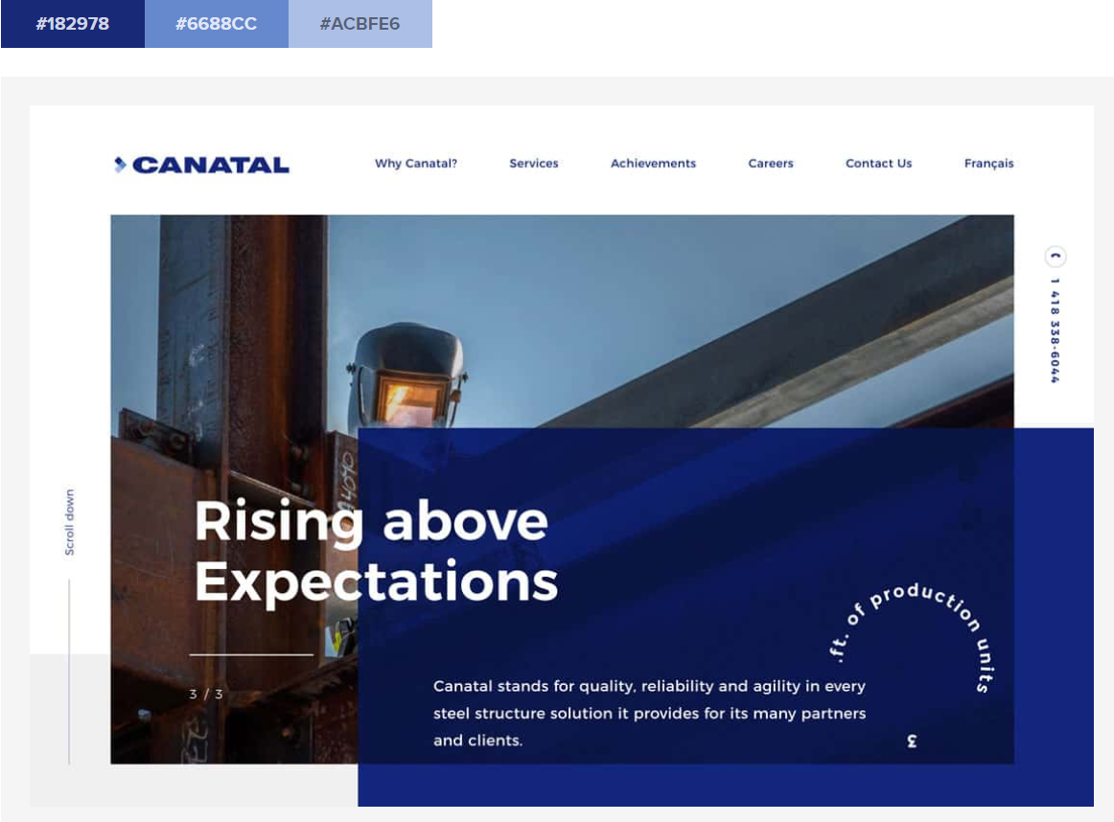
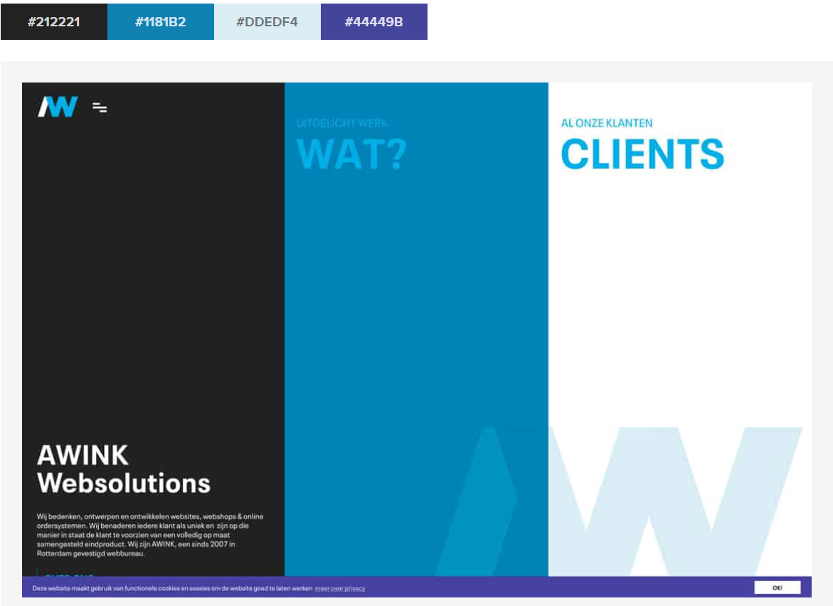
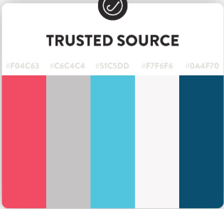
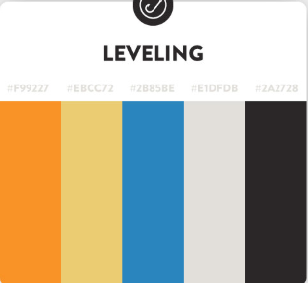
COLOUR PALETTES

Slide 19
FEEDBACK ON FONTS/COLOURS
Fonts:
Oxygen + Source sans: 111
Arvo + Lato:
Oswald + Merriweather:
Spectral + Karla:1
Colour Palettes:
Site 1:
Site 2:
Trusted Source:1111
Levelling:

Slide 20
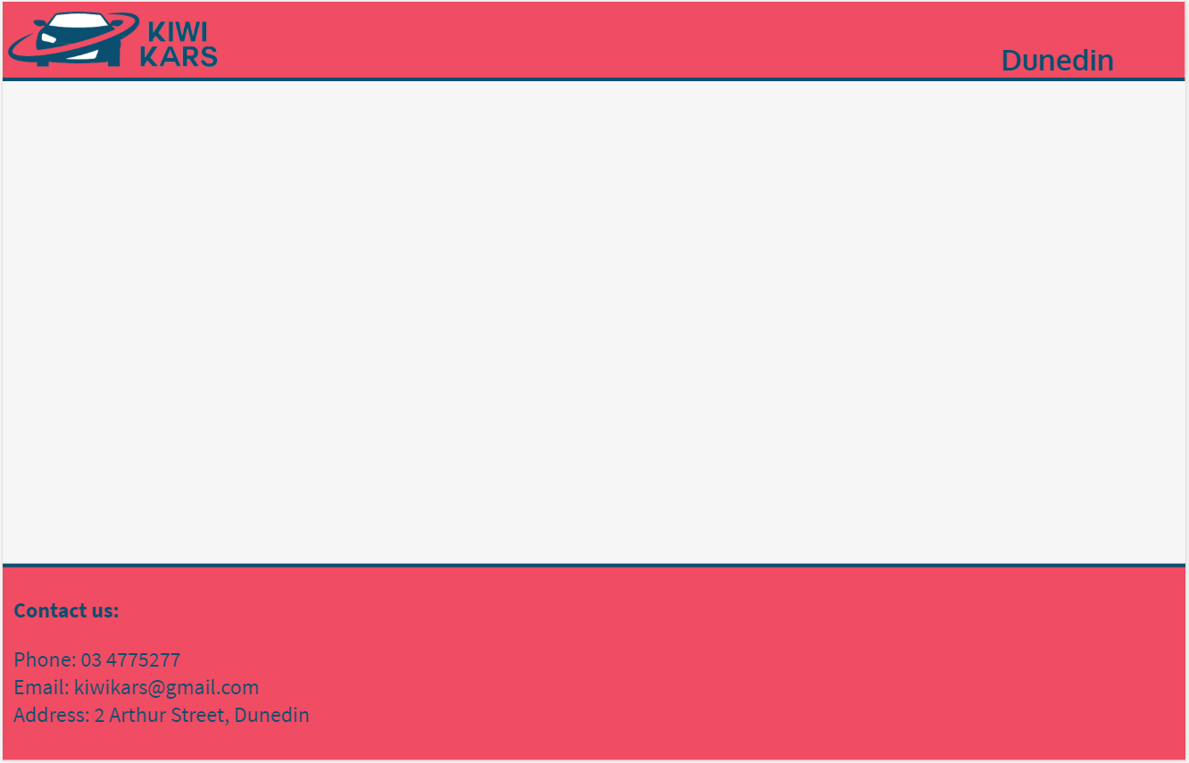
SITE SET UP

Slide 21
SET UP THE GUI

Slide 22
Day 1
Simple page setup
Added header
And footer

Slide 23
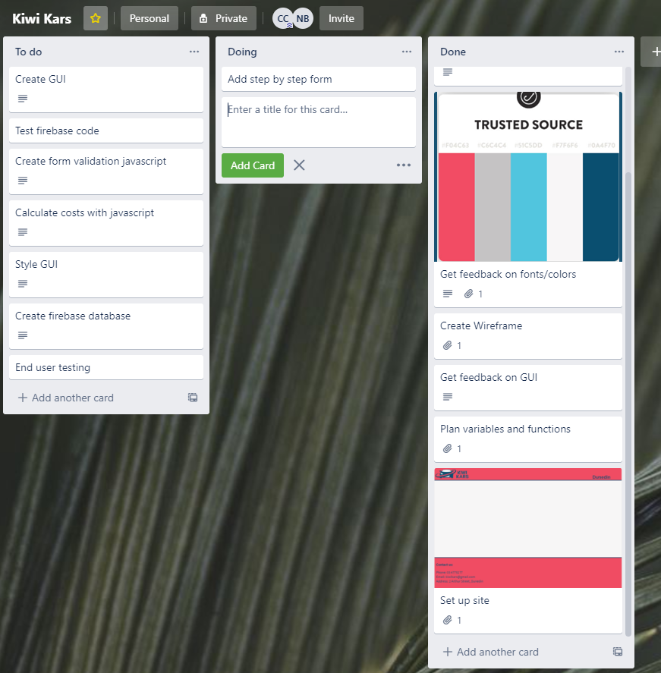
Trello

Slide 24
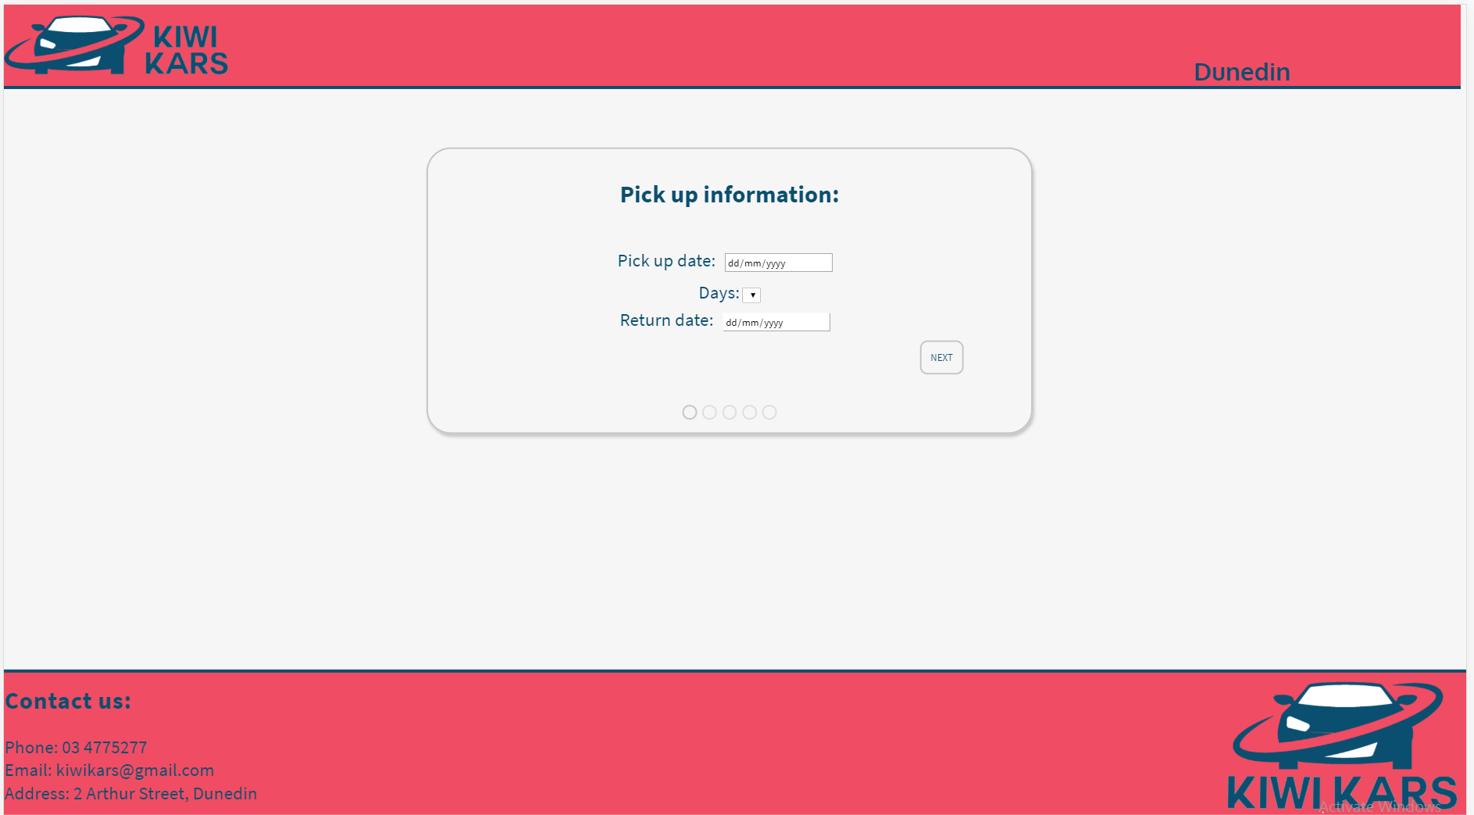
Day 2
Added the beginnings of the step by step form.
Added inputs to the first step page

Slide 25
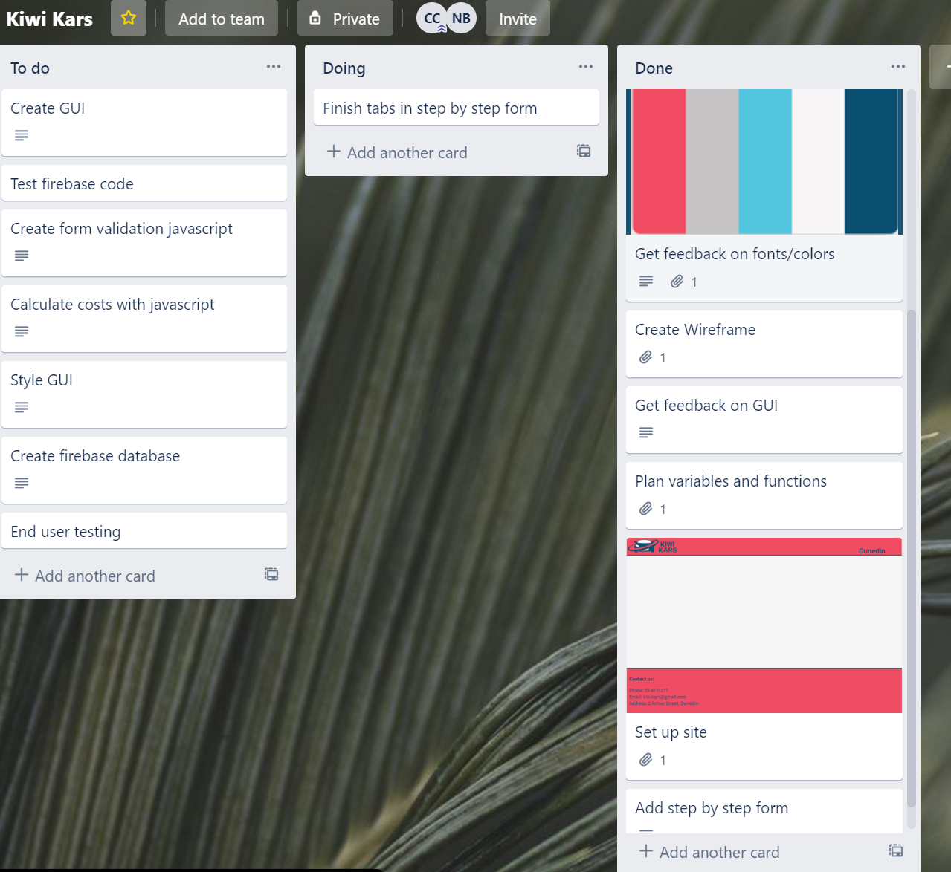

Slide 26
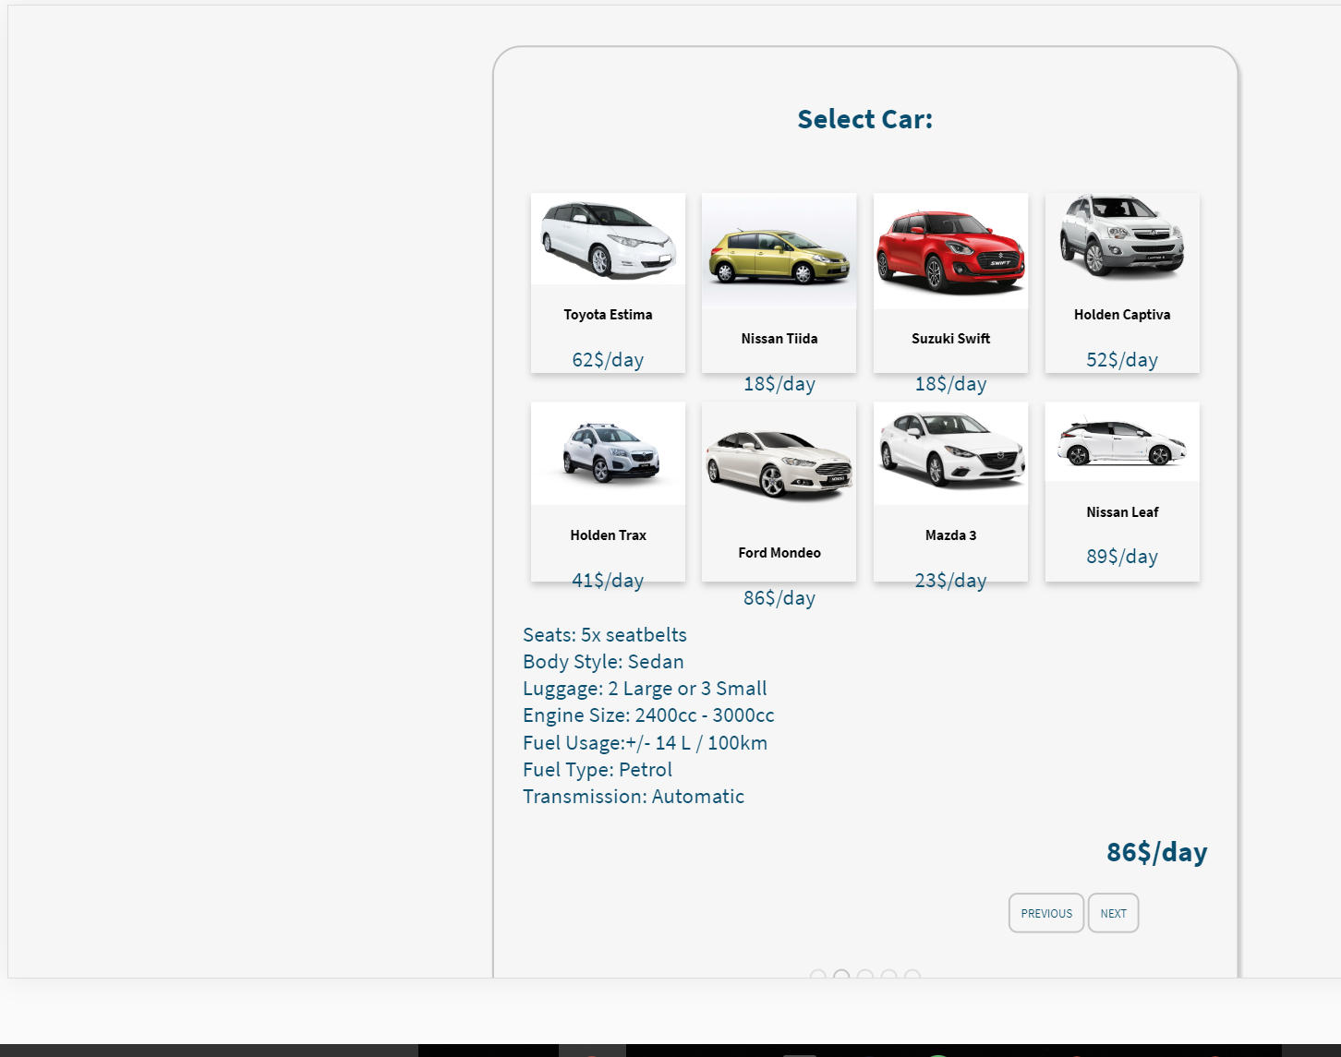
Site
Added cards to select a card

Slide 27
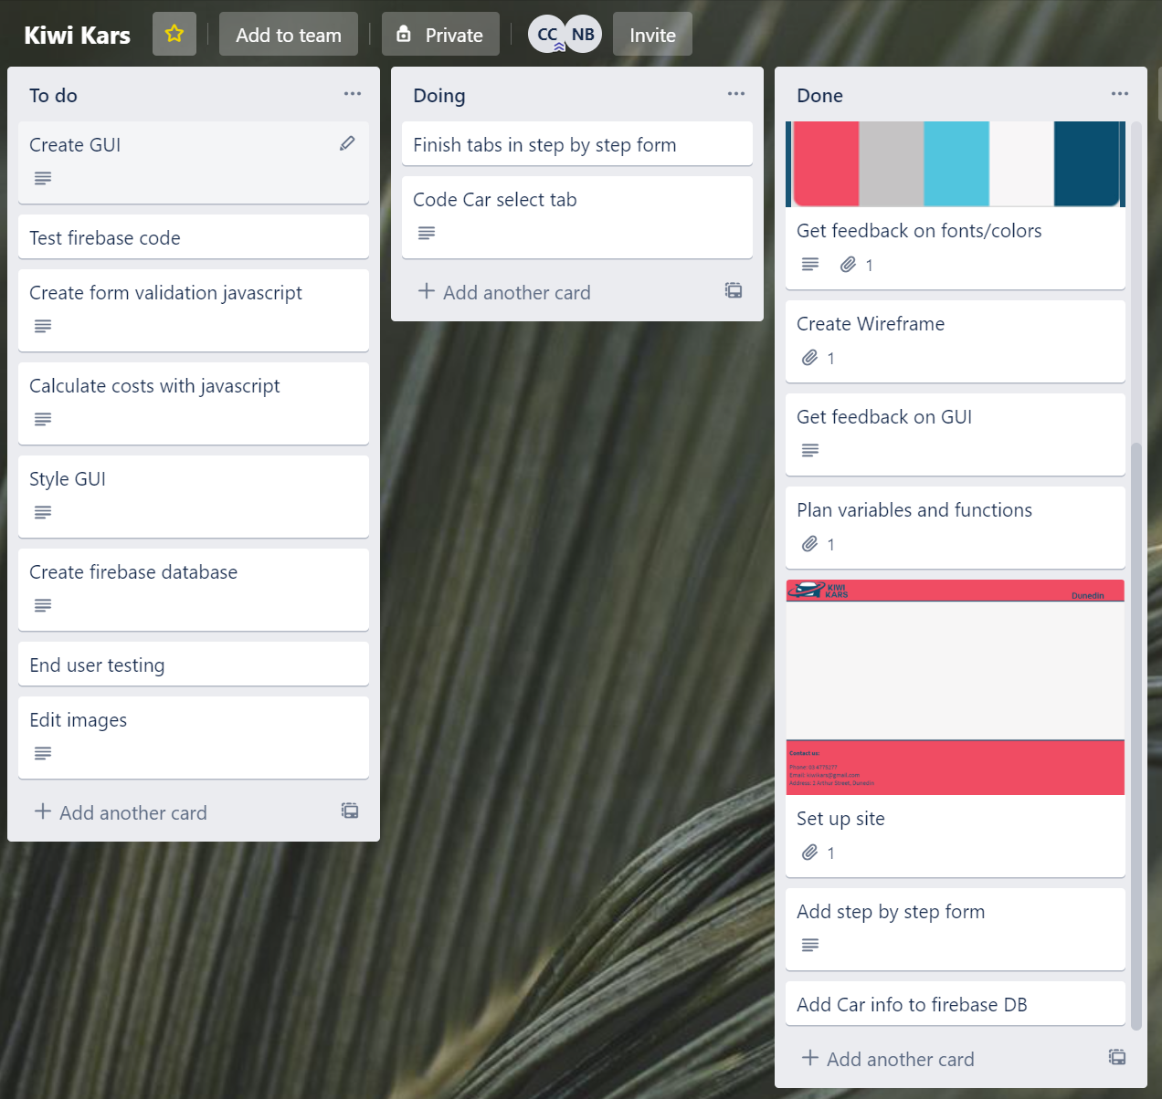

Slide 28
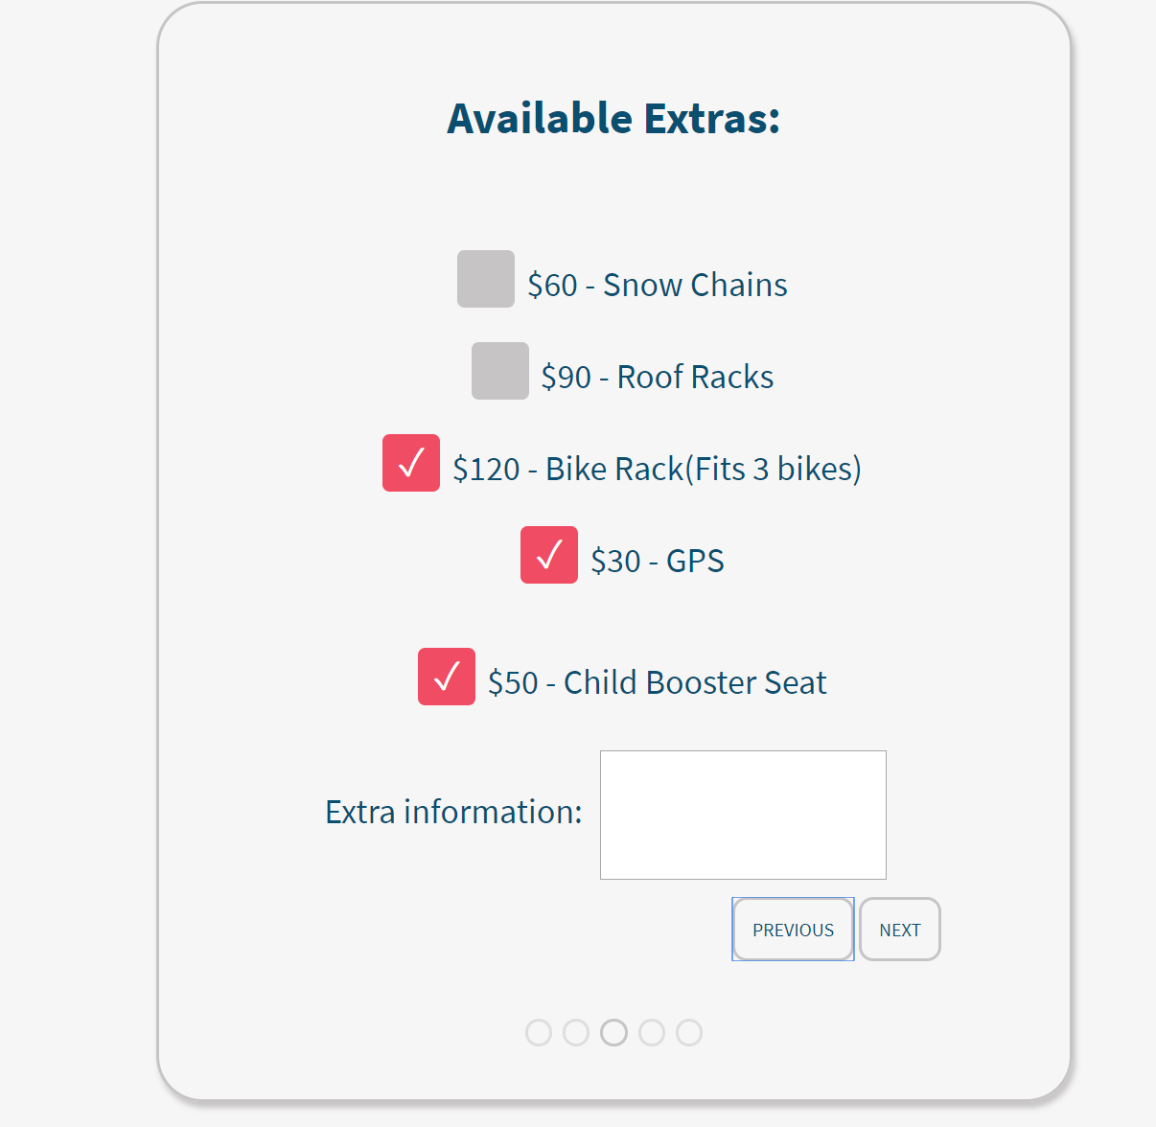

Slide 29
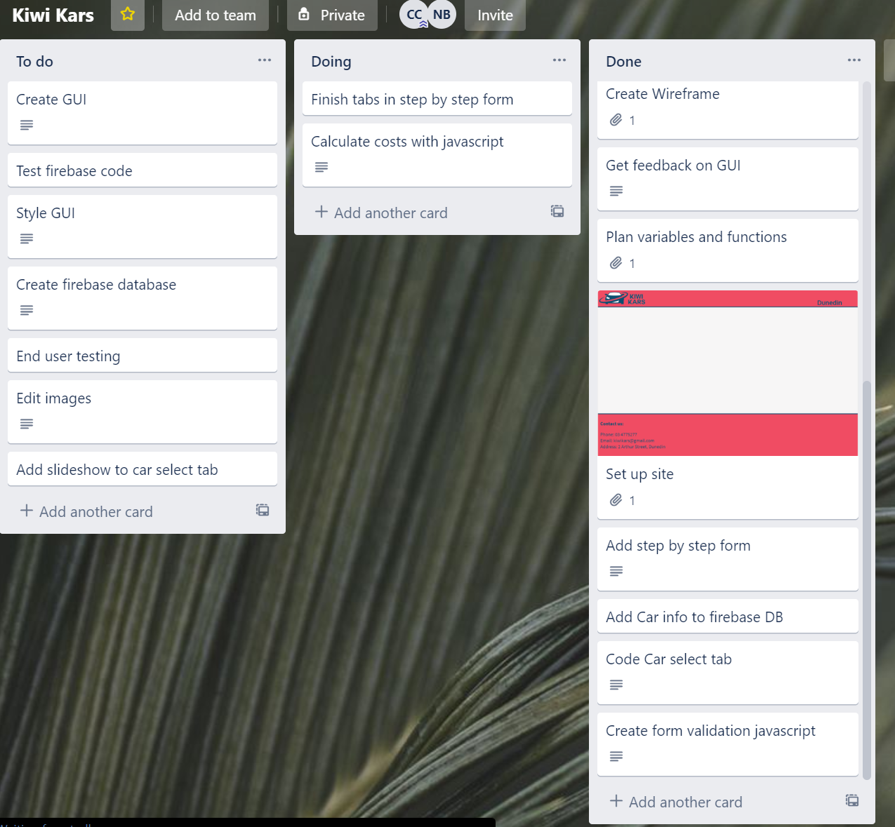
Trello

Slide 30
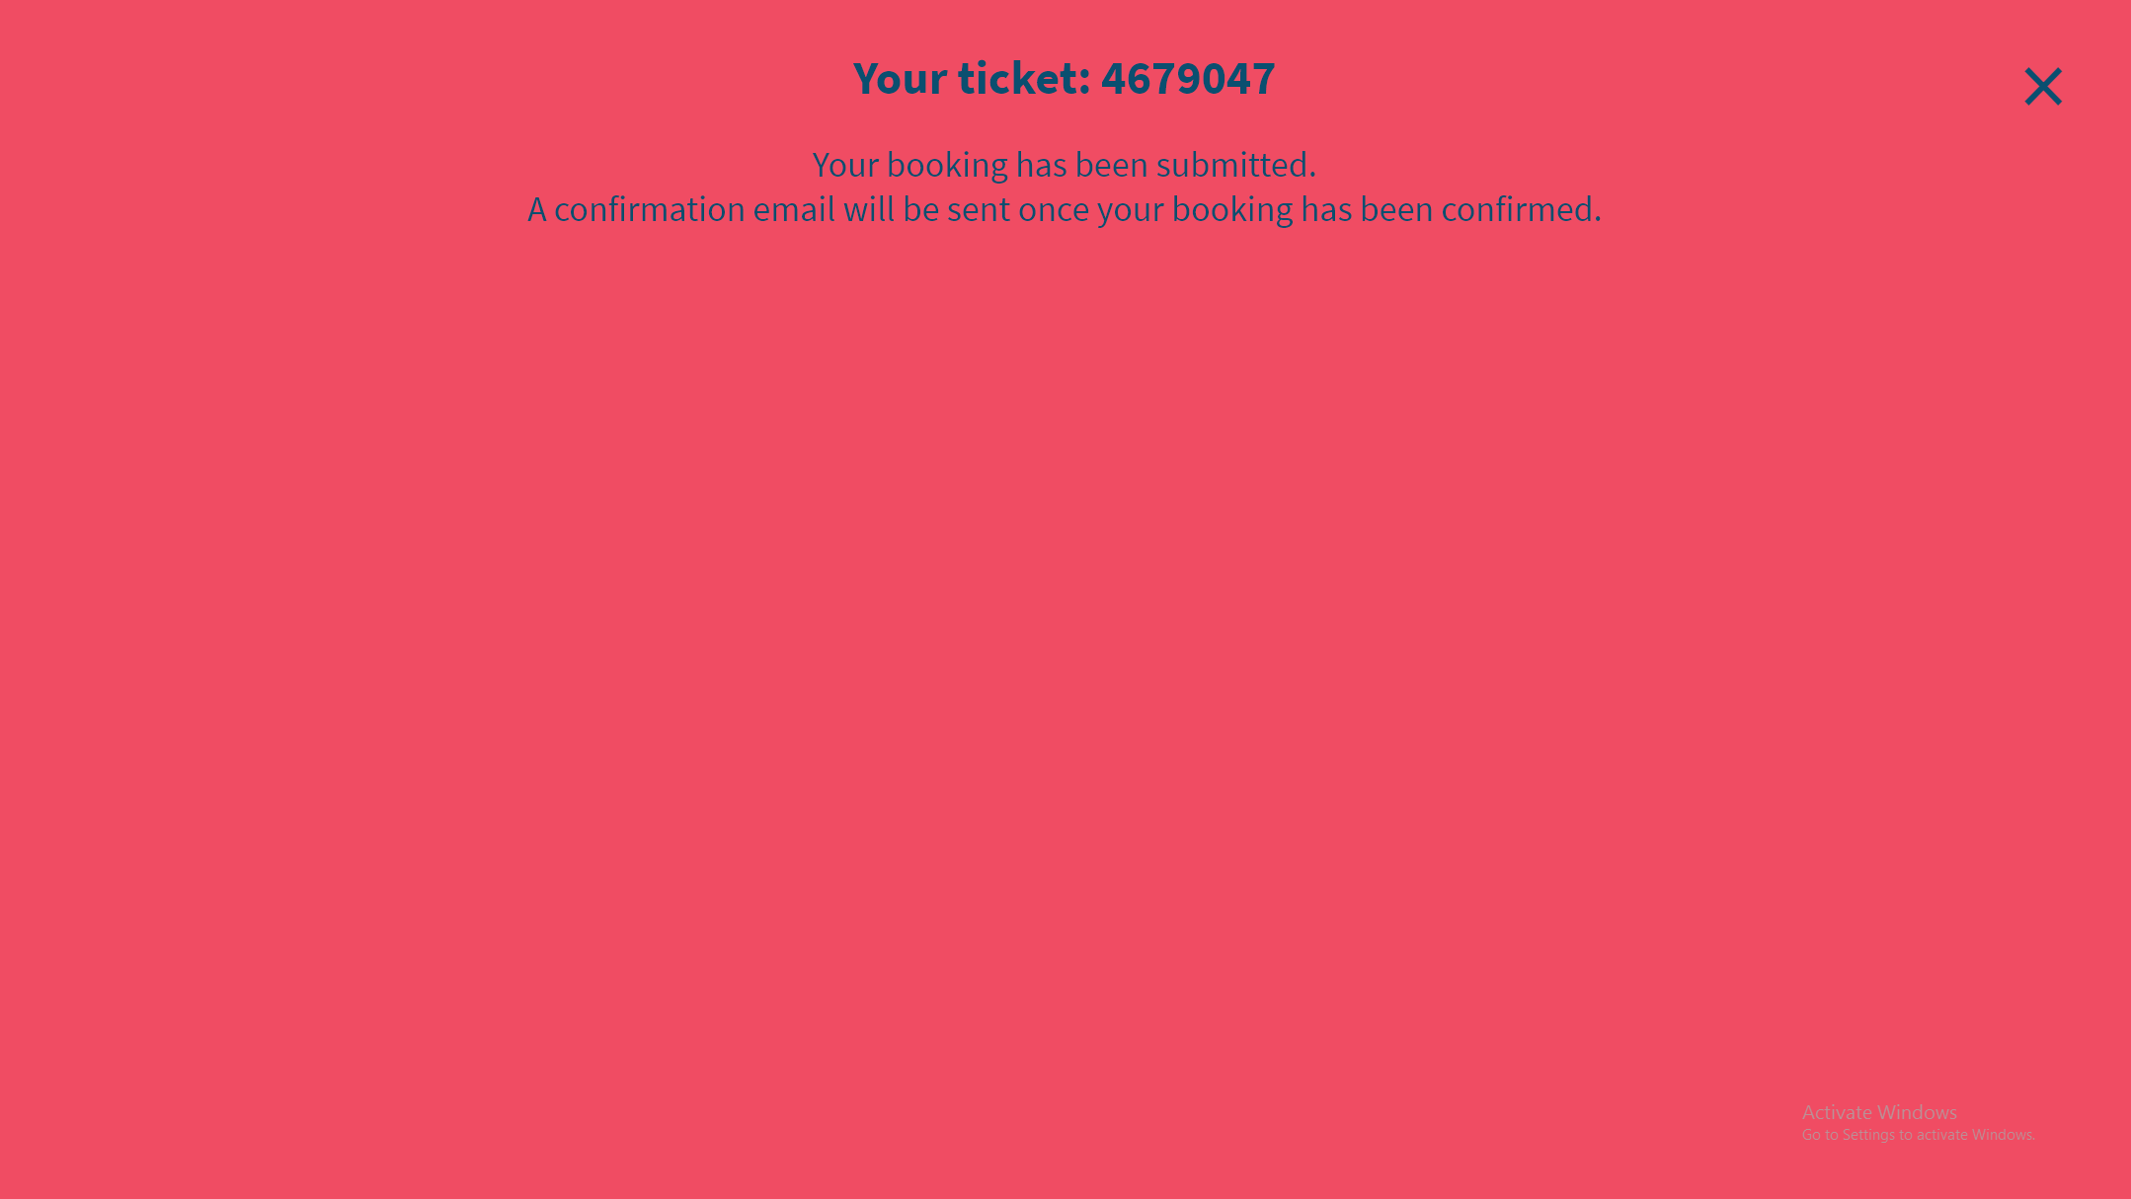

Slide 31
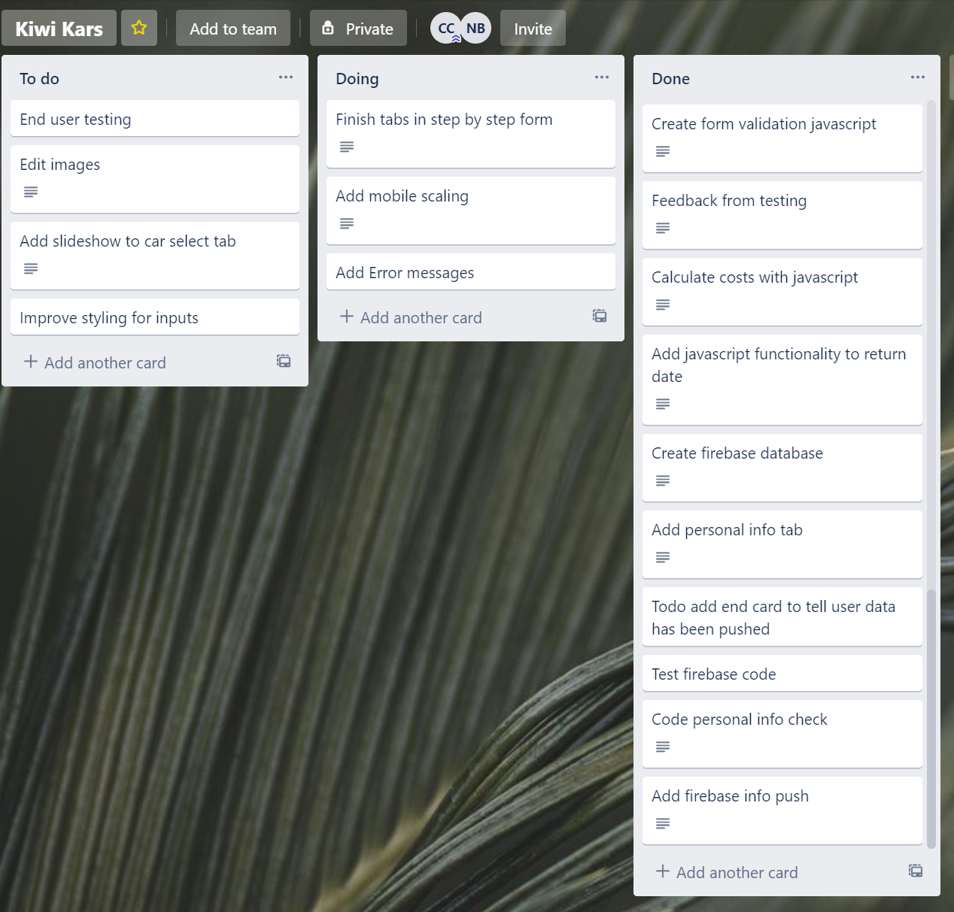
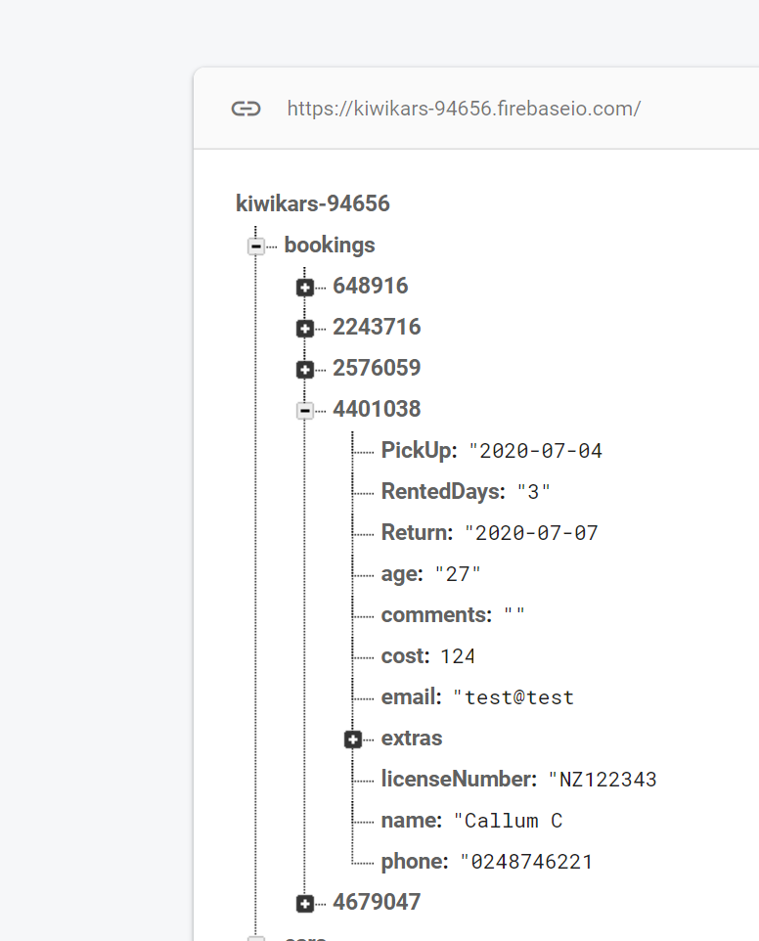
Trello

Slide 32
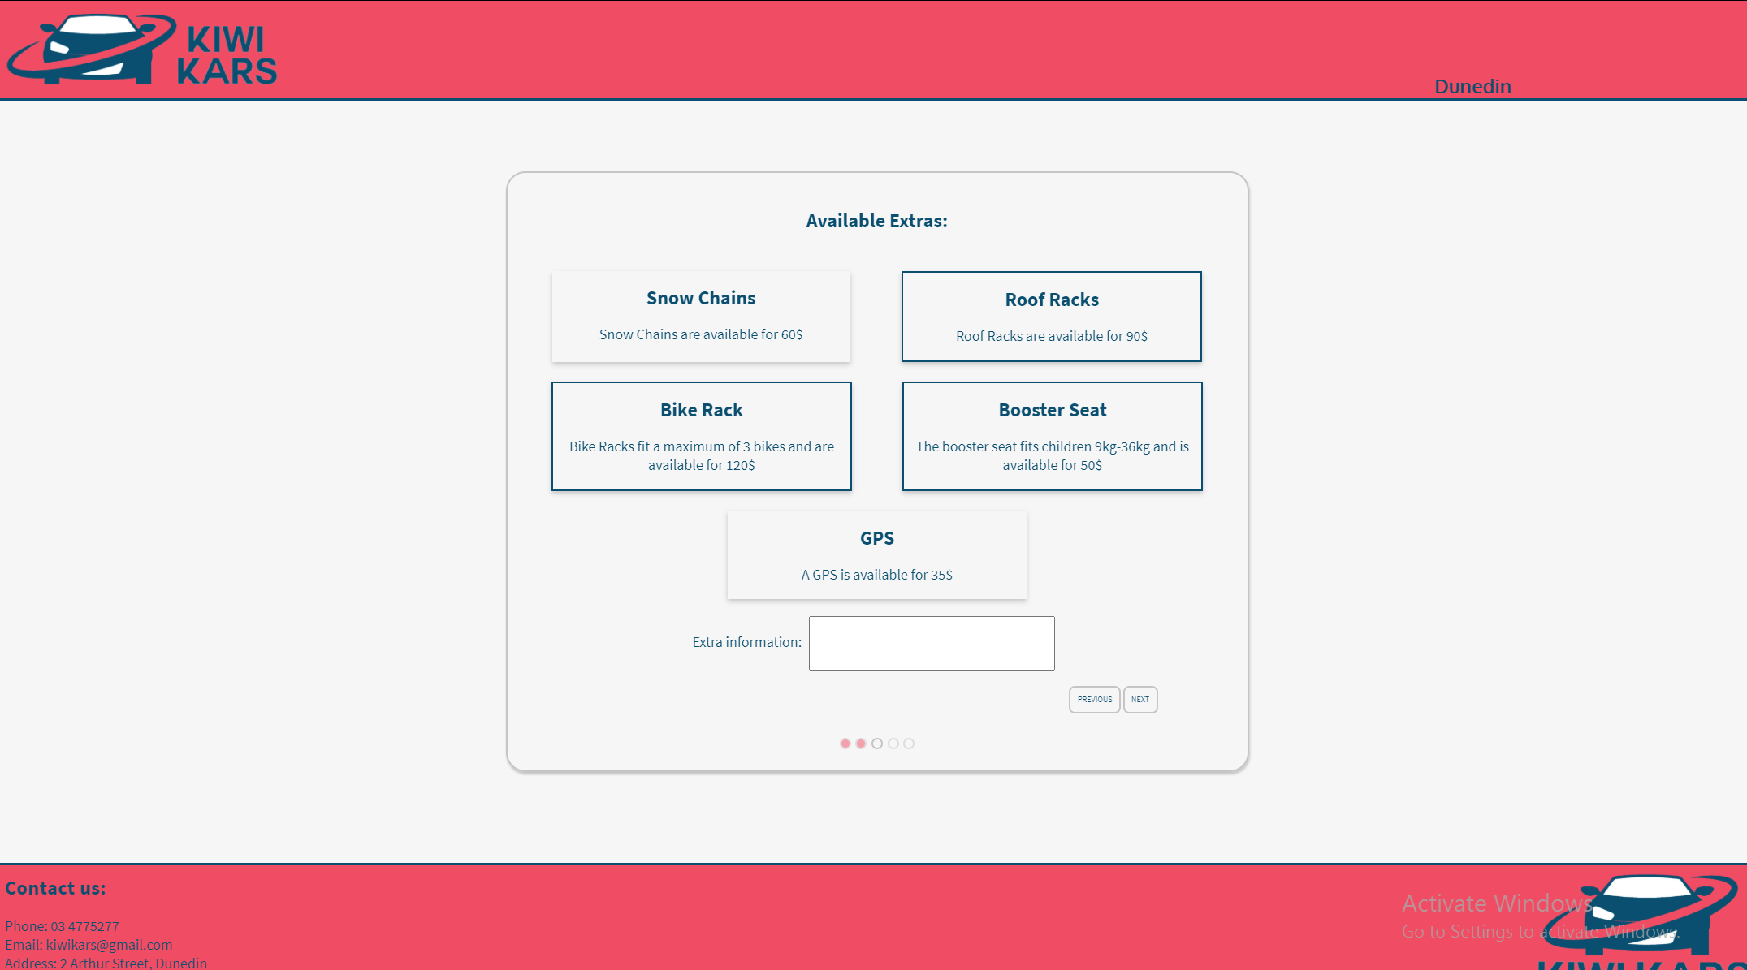

Slide 33
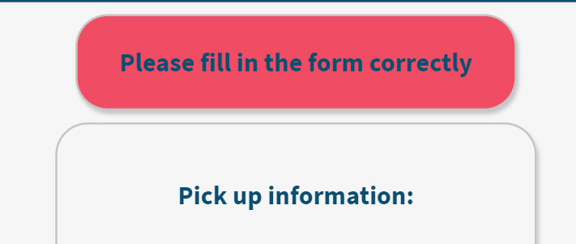
Added user friendly error messages
Informs the user
That their data is invalid

Slide 34
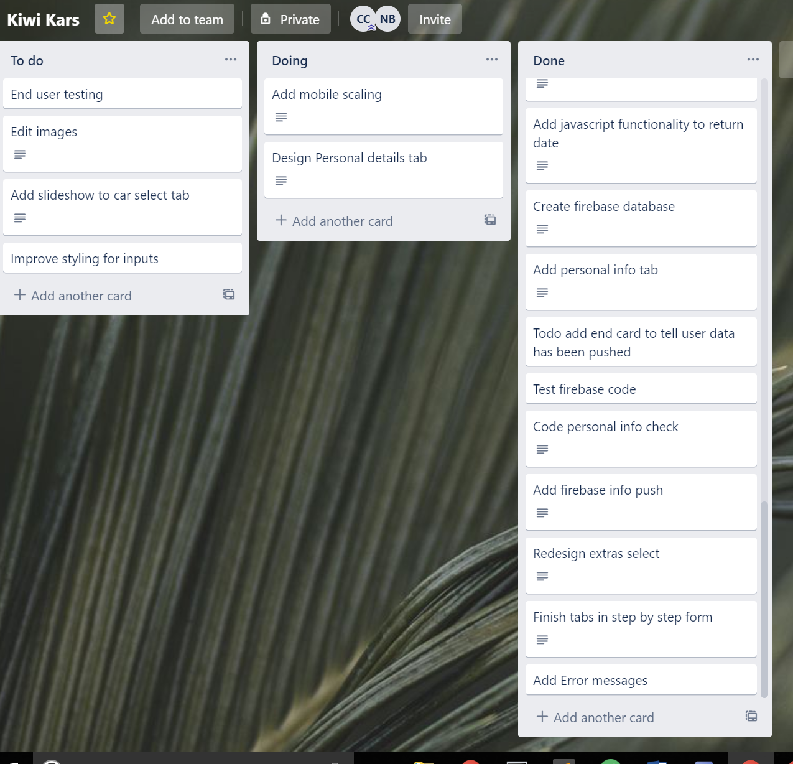
Trello

Slide 35
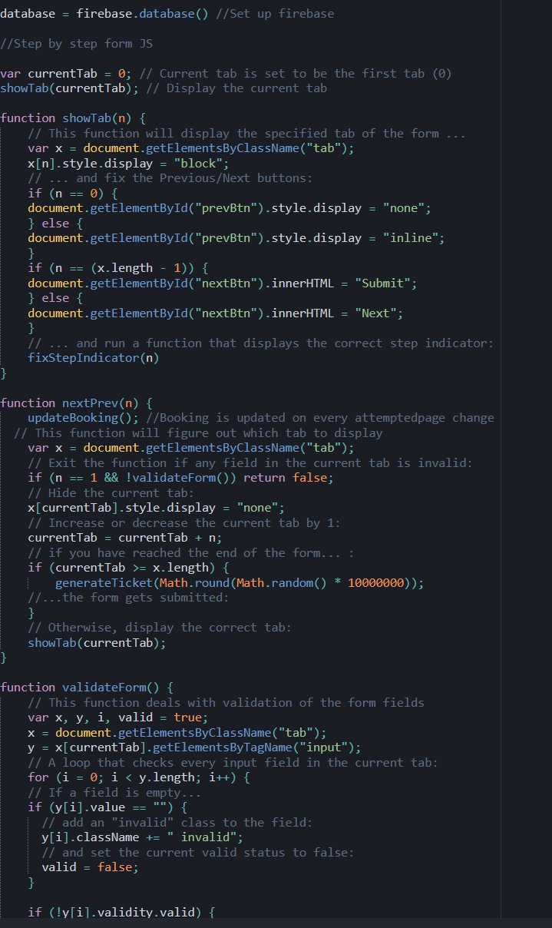
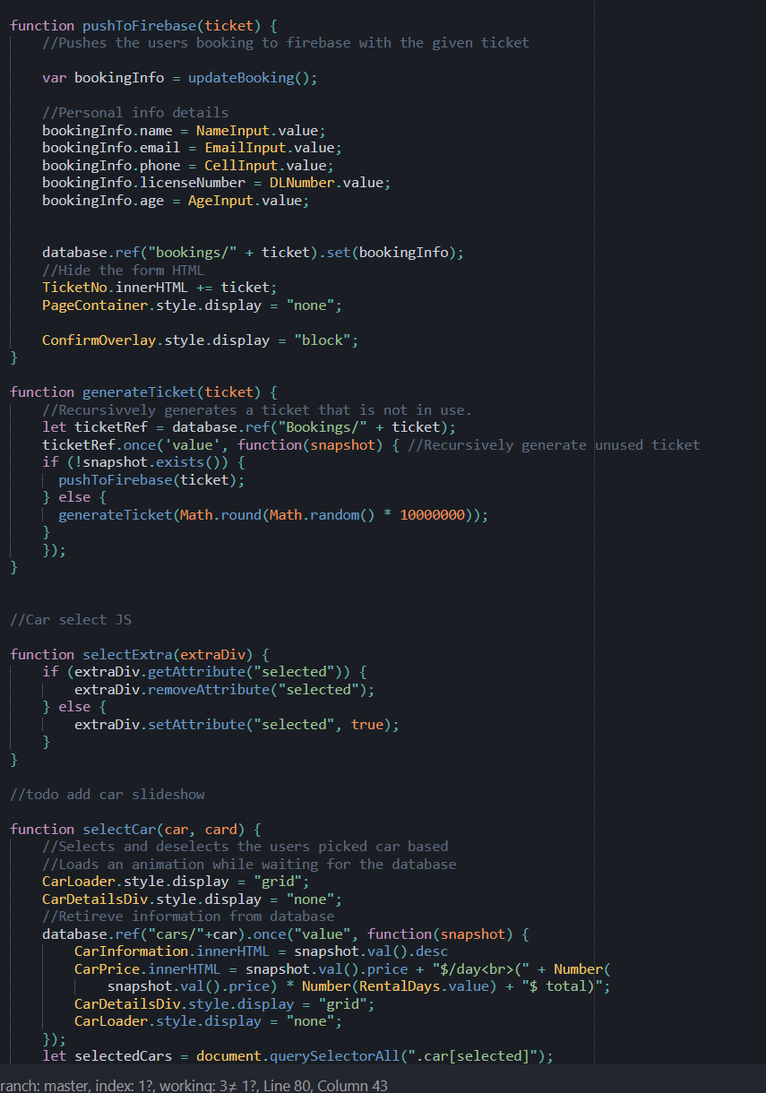
Javascript version control at https://github.com/callumc20171/3.7-Assessment

Slide 36
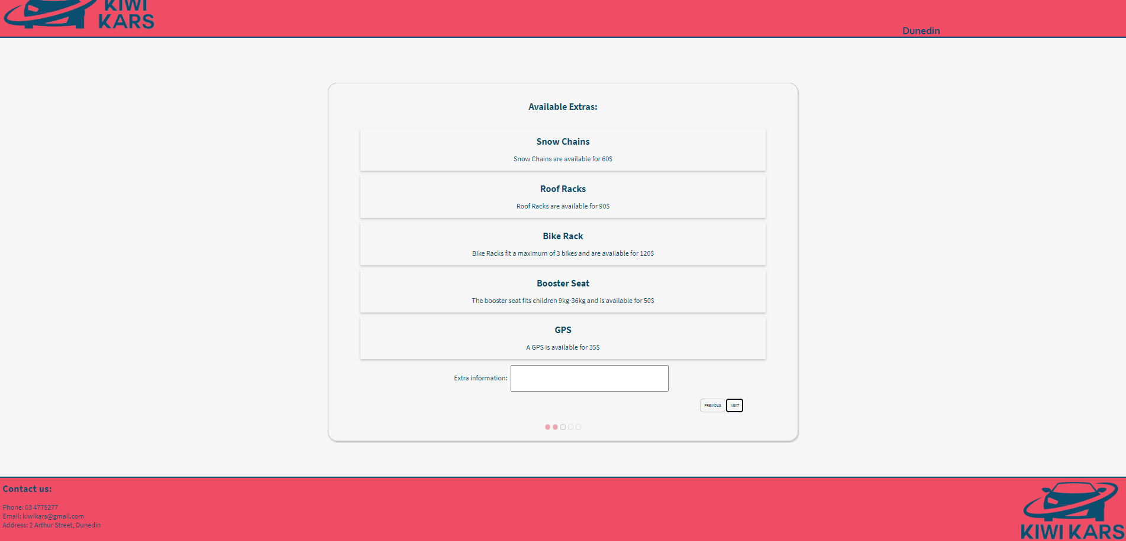
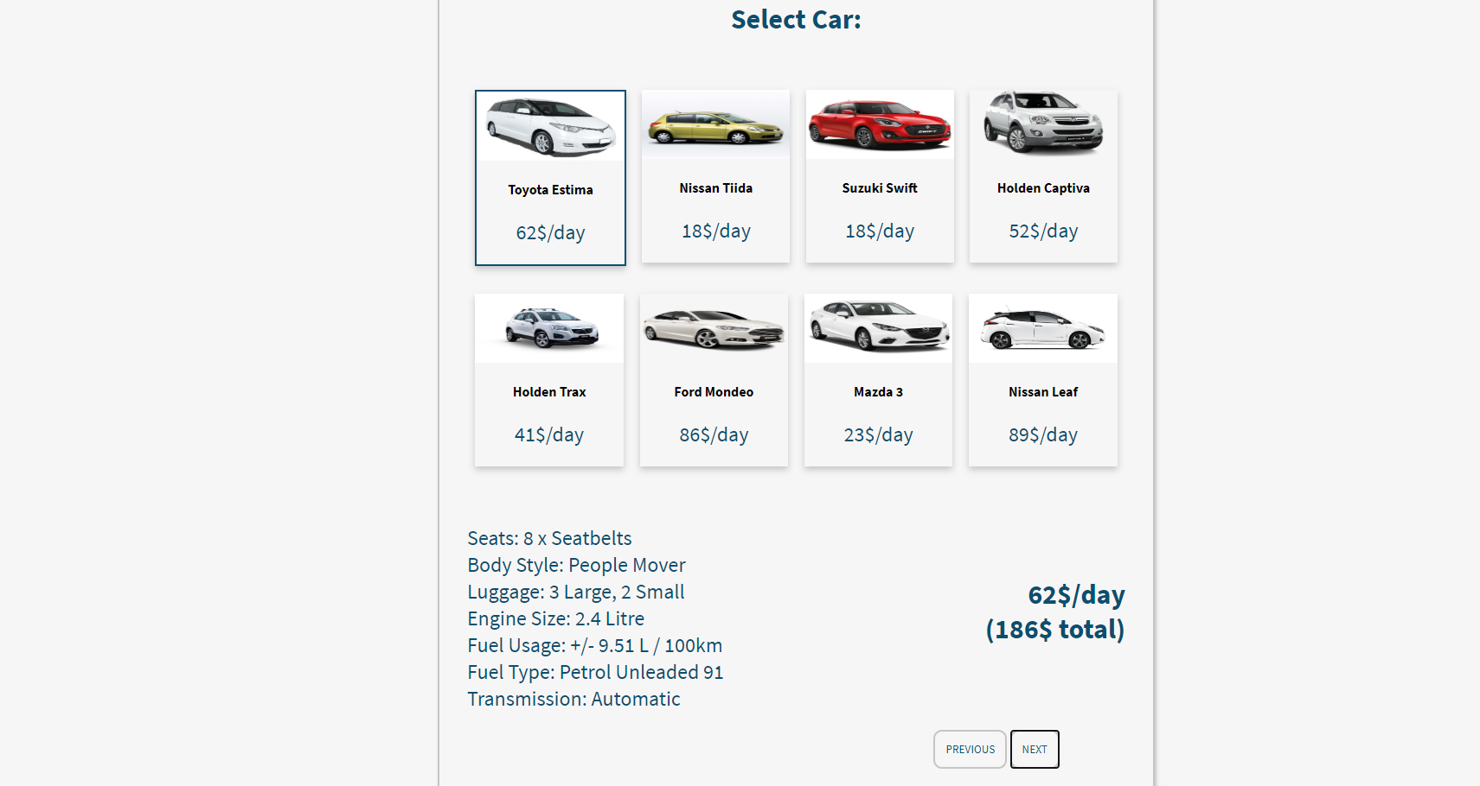
Feedback
Functionality –
You page is really awesome with how your able to go to the next card and able to go back but you need to fix the scaling on the pictures
Aesthetics – the colour combo and fonts are really good I could easily read everything with ease
You need make it scale better for phone view, maybe make it more obvious on what is going on and what to do

Slide 37
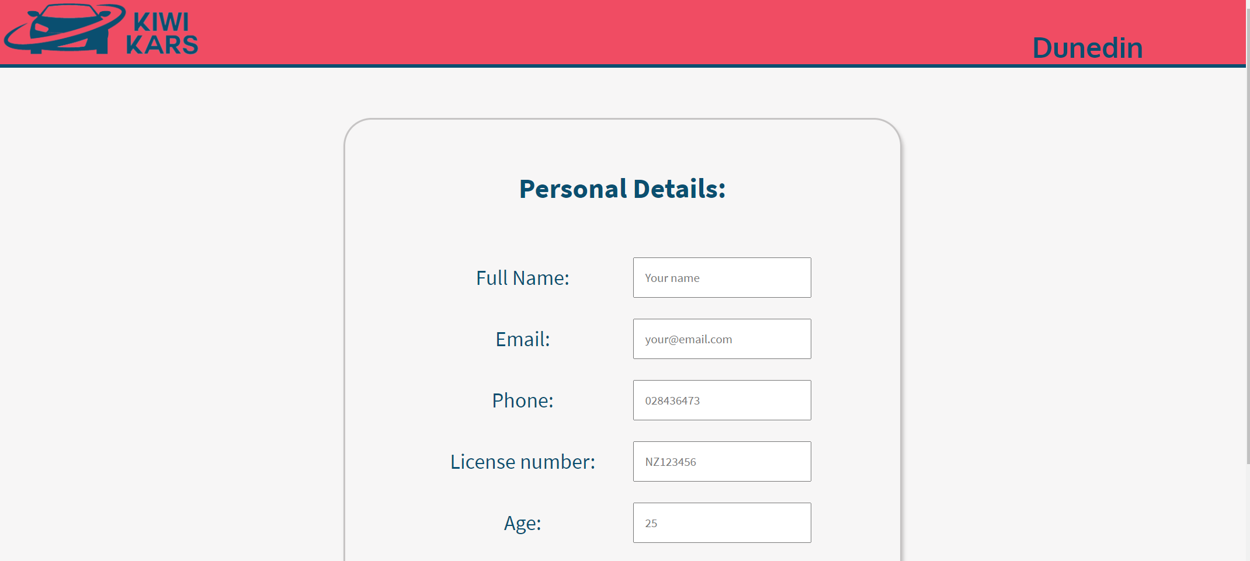

Slide 38
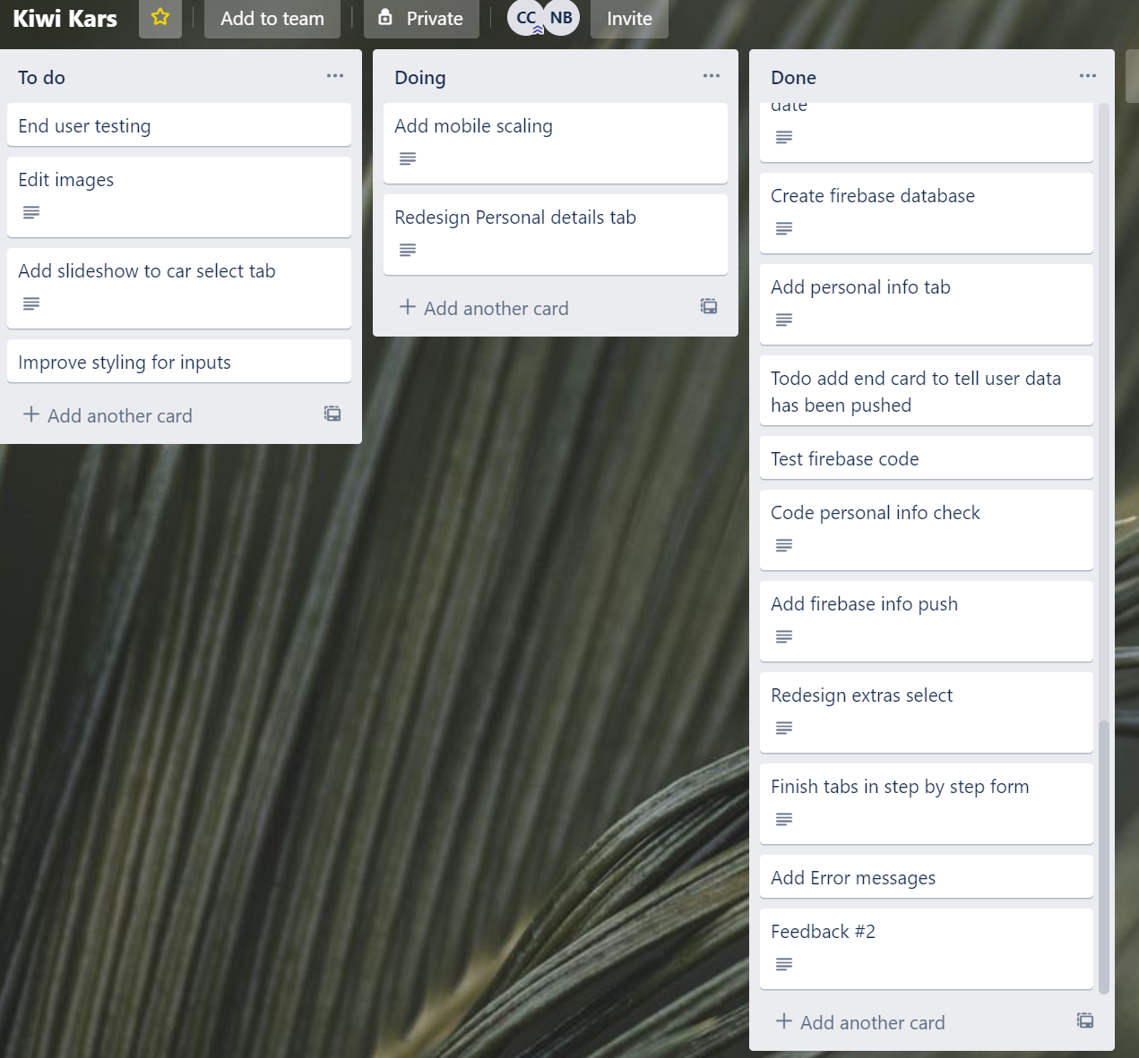
Trello

Slide 39
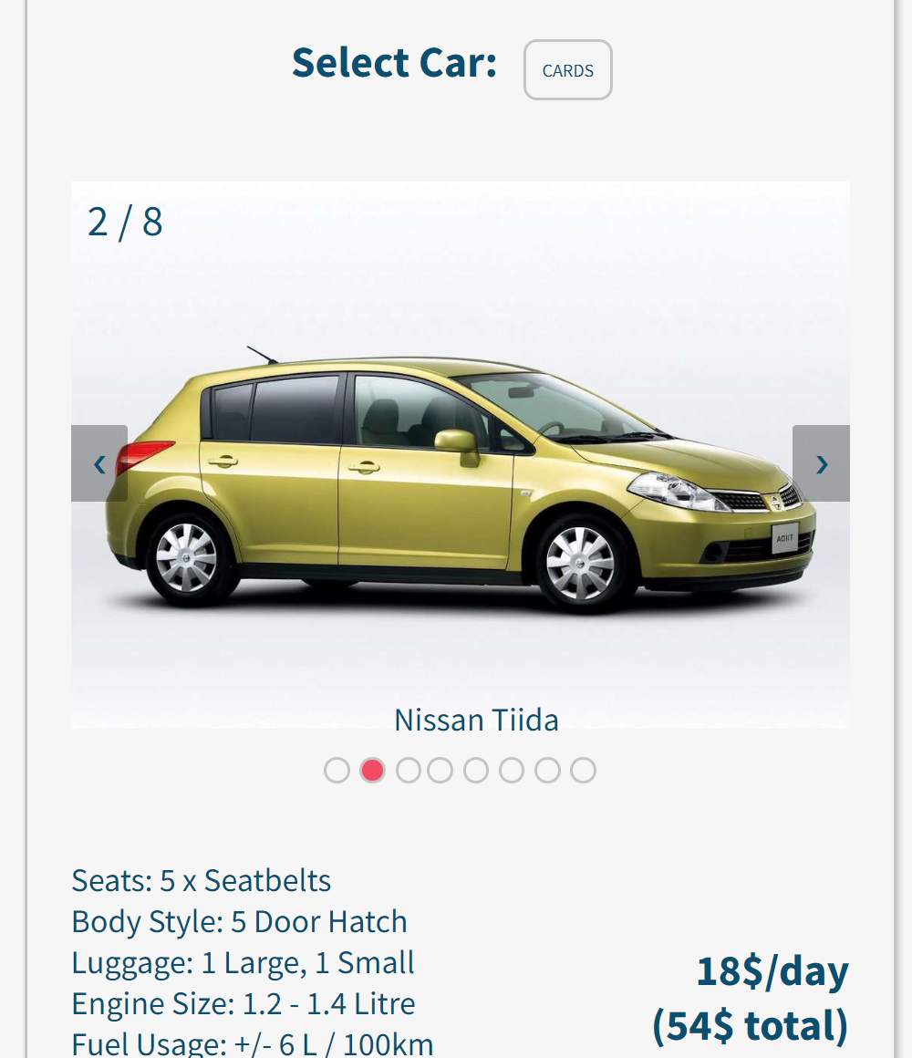

Slide 40
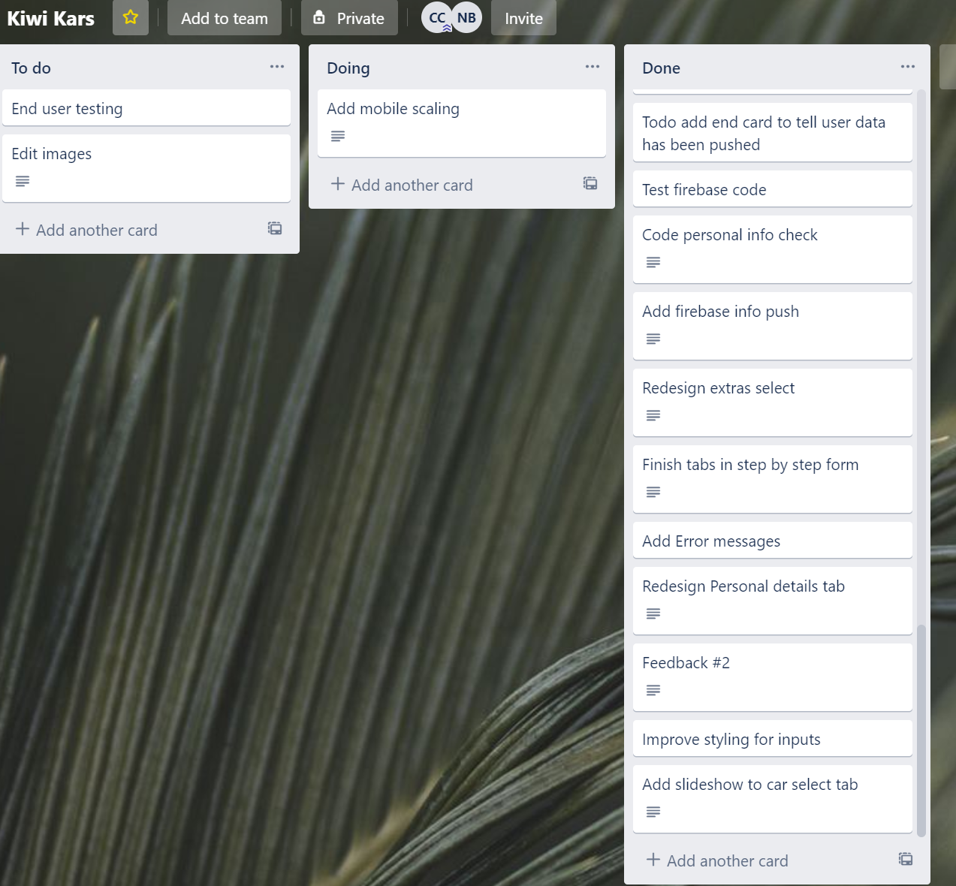
Trello

Slide 41
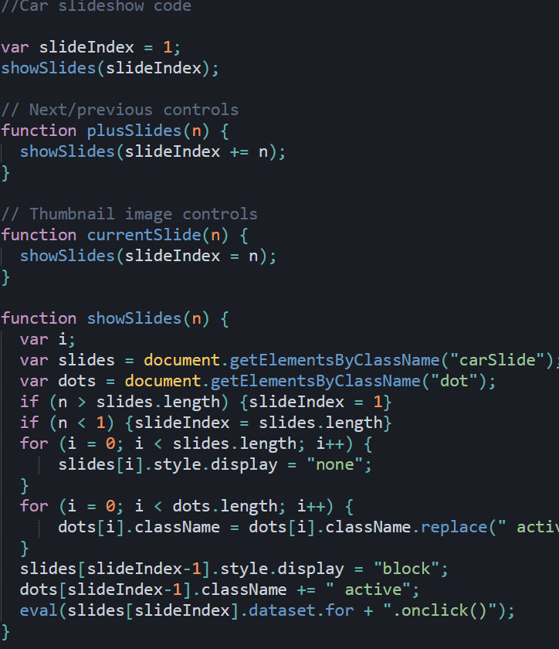
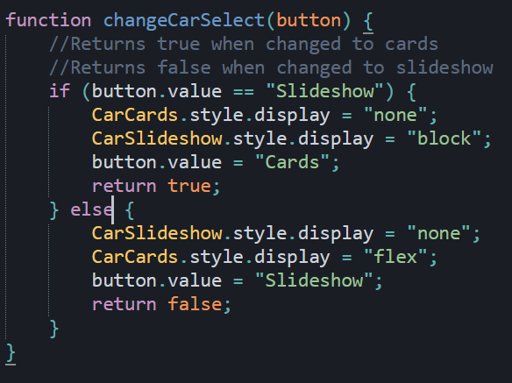
Javascript

Slide 42
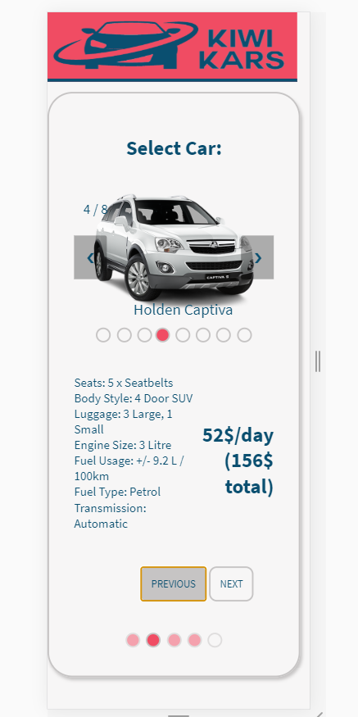
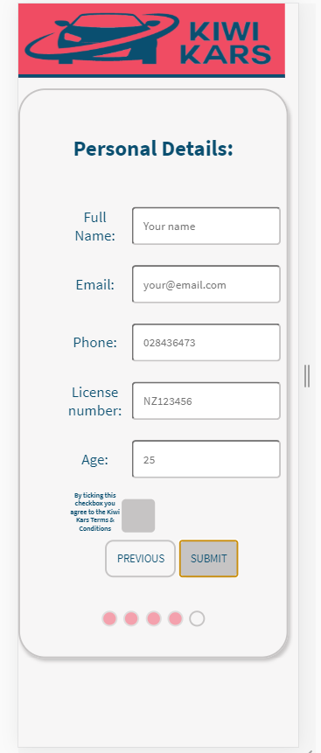
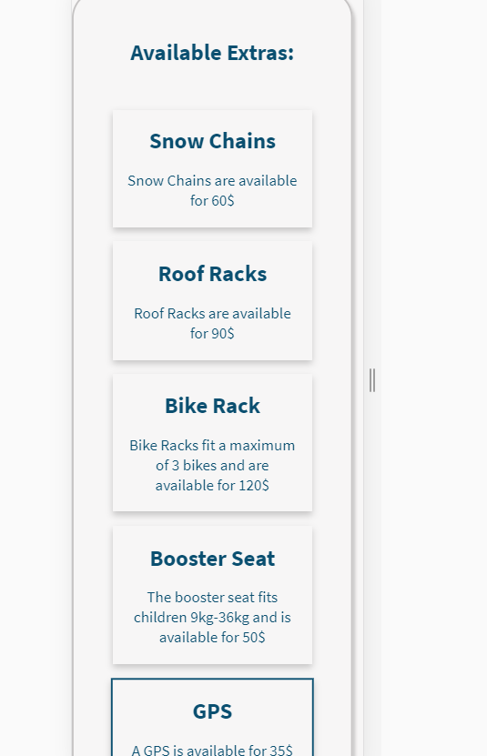

Slide 43
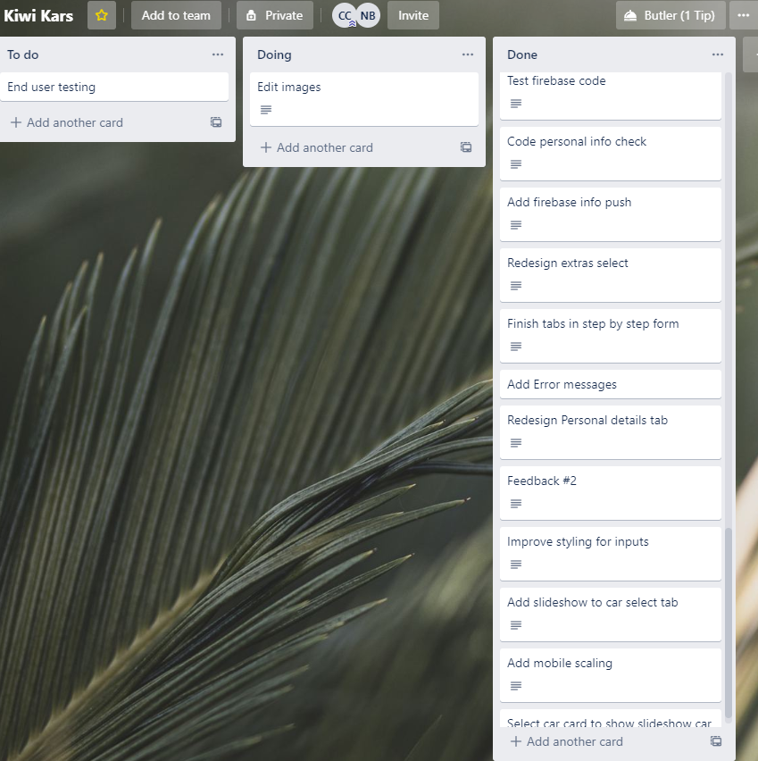
Trello

Slide 44
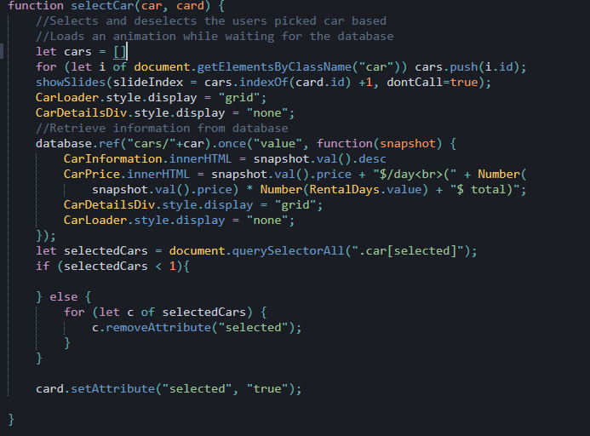
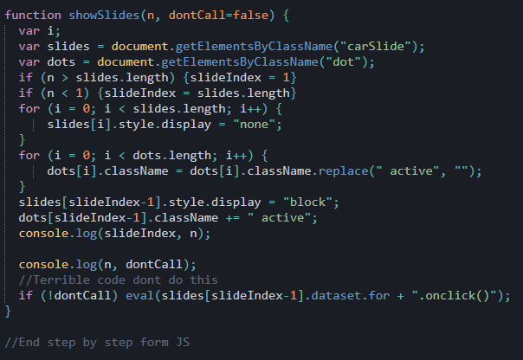
Javascript

Slide 45
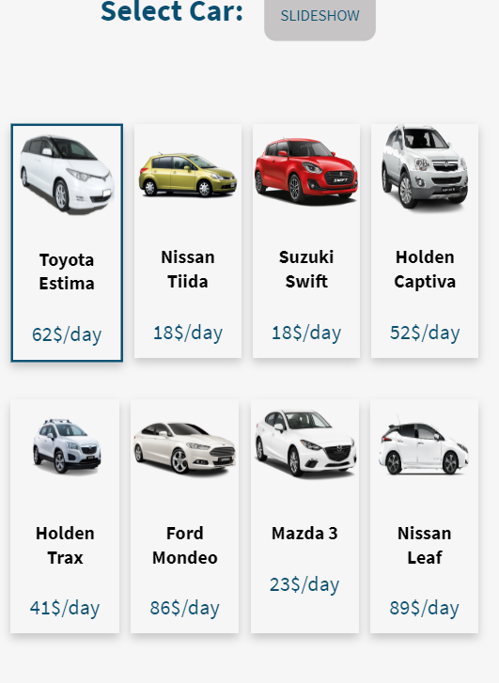
Editing photos
Used Photoshop to remove all white
Backgrounds from images.

Slide 46
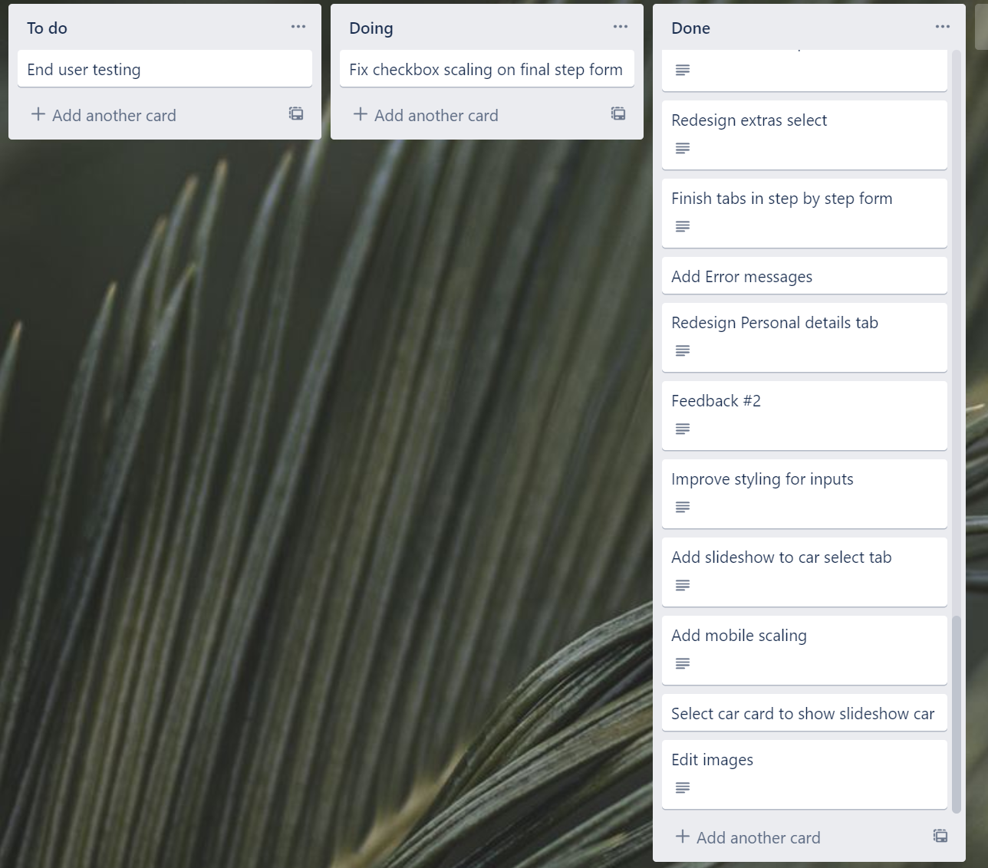
Trello

Slide 47
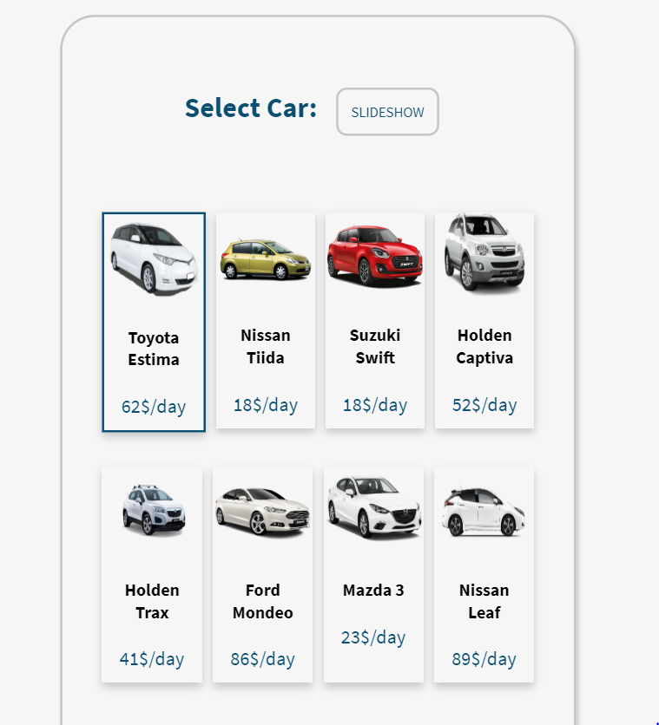
Site

Slide 48



TRIALING INPUTS
Prevents user from booking a date that is before today.
Borderline date also does not allow the user to continue
Patterns are used to ensure that user information is valid. Form will not submit without valid data.

Slide 49

Javascript
Checks all booking info

Slide 50

Feedback – Functionality – Usability - Aesthetics
1)Functionality outstanding, very easy but not so scalable. The aesthetics are nice on the eyes and comfortable.

Slide 51


Adding Custom errors

Slide 52

Trello

Slide 53


Added labels to trello

Slide 54
Every LESSON – TAKE A SCREENSHOT OF YOU USING YOUR TRELLO BOARD – ADDING NOTES TO YOUR CARDS ETC AND A SCREENSHOT OF YOUR CODE AND GUI

Slide 55
TRIALING INPUTS

Slide 56
FEEBACK ON THE FUNCTIONALITY

Slide 57
FEEBACK ON THE ASETHETHICS

Slide 58
FEEBACK ON THE USABILILTY

Slide 59
TRIALING LAYOUTS

Slide 60
TRIALING OUTPUTS / ERROR MESSAGES

Slide 61
TRIALING OUTPUTS / ERROR MESSAGES

Slide 62
IMPROVING THE FUNCTIONALITY

Slide 63
TRIALING OUTPUTS / ERROR MESSAGES

Slide 64
DEBUGGING : WORKS ON EXPECTED DATA

Slide 65
DEBUGGING : WORKS ON EXPECTED DATA

Slide 66
DEBUGGING : WORKS ON EXPECTED DATA

Slide 67
DEBUGGING : WORKS ON EXPECTED DATA

Slide 68
DEBUGGING : WORKS ON EXPECTED DATA

Slide 69
DEBUGGING : WORKS ON BOUNDARY DATA

Slide 70
DEBUGGING : WORKS ON BOUNDARY DATA

Slide 71
DEBUGGING : WORKS ON INVALID DATA

Slide 72
FEEDBACK ON GUI

Slide 73
REFINEMENTS

Slide 74
REFINEMENTS

Slide 75
REFINEMENTS

Slide 76
EVIDENCE OF CODE VALIDATION (HTML)

Slide 77
EVIDENCE OF CODE VALIDATION (CSS)

Slide 78
EVIDENCE OF CODE VALIDATION (JS)

Slide 79
EVIDENCE OF CODE COMMENTS (HTML/CSS/JS)

Slide 80
PERSISTENT STORAGE (FIREBASE DATABASE) SETUP

Slide 81
PERSISTENT STORAGE (FIREBASE DATABASE)
Firebase database

Slide 82
PERSISTENT STORAGE (FIREBASE DATABASE)
Final video of testing evidence / split screened GUI with Firebase

